Slide 1
LSI design training with SKY130
Analog LSI design Part 1
Mizuki Mori , https://github.com/3zki
Last update: 2024/12/31

Slide 2
Log
2024/12/31 Initial release of English version

Slide 3
Lab data
Development Environment Setup Script (Windows WSL + Ubuntu 22)
https://github.com/3zki/wsl_osic
Analog LSI design Part 1
https://github.com/3zki/lab240921
Please download these materials by “ git clone “ etc…

Slide 4
Analog LSI design Part 1
Make a CMOS inverter (NOT logic gate)
Background knowledge
Schematic design
Layout design
Post layout simulation (Parasitic extraction)

Slide 5
Background knowledge of LSI
Planar FET structure

Slide 6
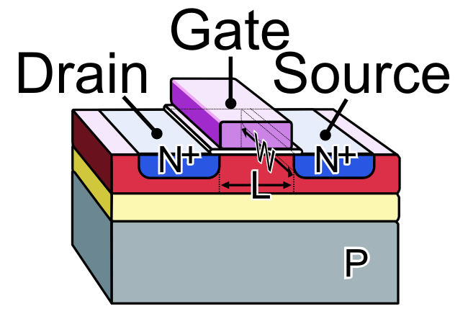
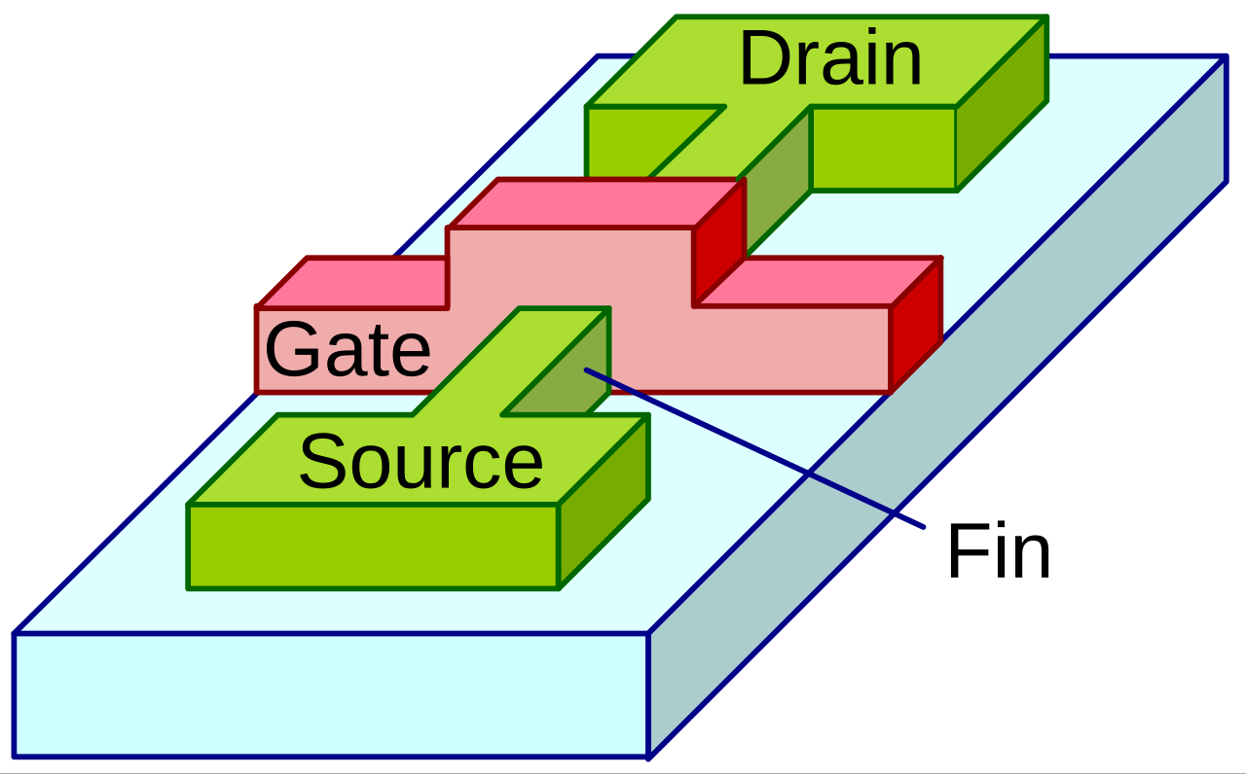
What is LSI?
There are various types of LSIs. Design methods and characteristics differ among them.
SKY130 and GF180MCU are planar MOSFET process ☞ We can make Pch MOSFET and Nch MOSFET
The manufacturing limit for planar FET is about 28 nm. High-density logic circuits such as CPU use completely different process such as FinFET and GAA-FET.
Planar 130nm is obsoleted for logic circuits, but cheaper than the FinFET and still be used for analog LSI.
Planar FET (~28nm)
FinFET (25nm ~ 7nm)
https://commons.wikimedia.org/wiki/File:Multigate_models.png
https://commons.wikimedia.org/wiki/File:MOS-FET_gate_model_(n-channel)_E.PNG

Slide 7
What can we make with the planar FET process?
Planar MOSFET: PMOS, NMOS
SKY130 supports 1.8V, 3.3V 5.0V, 10.5V, 16V, 20V devices
Diode
Resistor: Polysilicon resistor, Active Resistor (Diffusion Resistor), Nwell Resistor
Capacitor: MOS capacitor, Diffusion Capacitor, MIMCAP*, MOMCAP(Metal-Oxide-Metal)
Varactor diode(Varicap)*
Lateral bipolar transistor*: PNP, NPN
* = Not supported for some processes. SKY130 supports them.

Slide 8
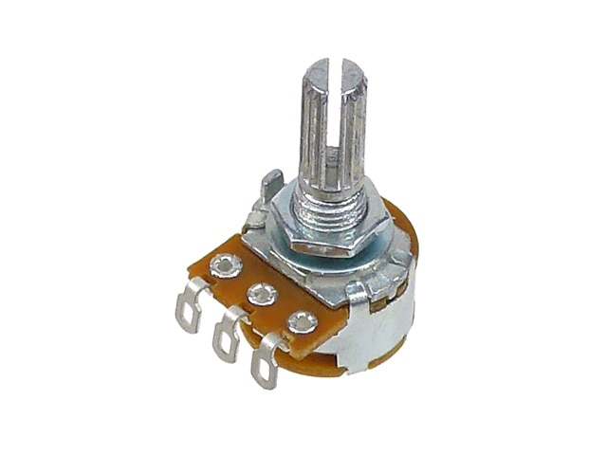
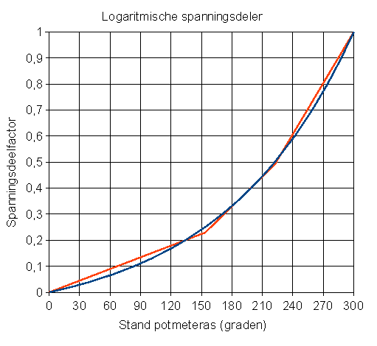
What is the MOSFET?
Similar to a potentiometer.
Turning the knob changes the resistance from ≒ 0Ω.
Main characteristics are taper and maximum resistance value.
Taper: relation between the angle of knob and the resistance. (For example: log, linear, inverse-log)

Slide 9
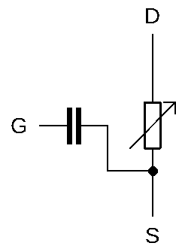
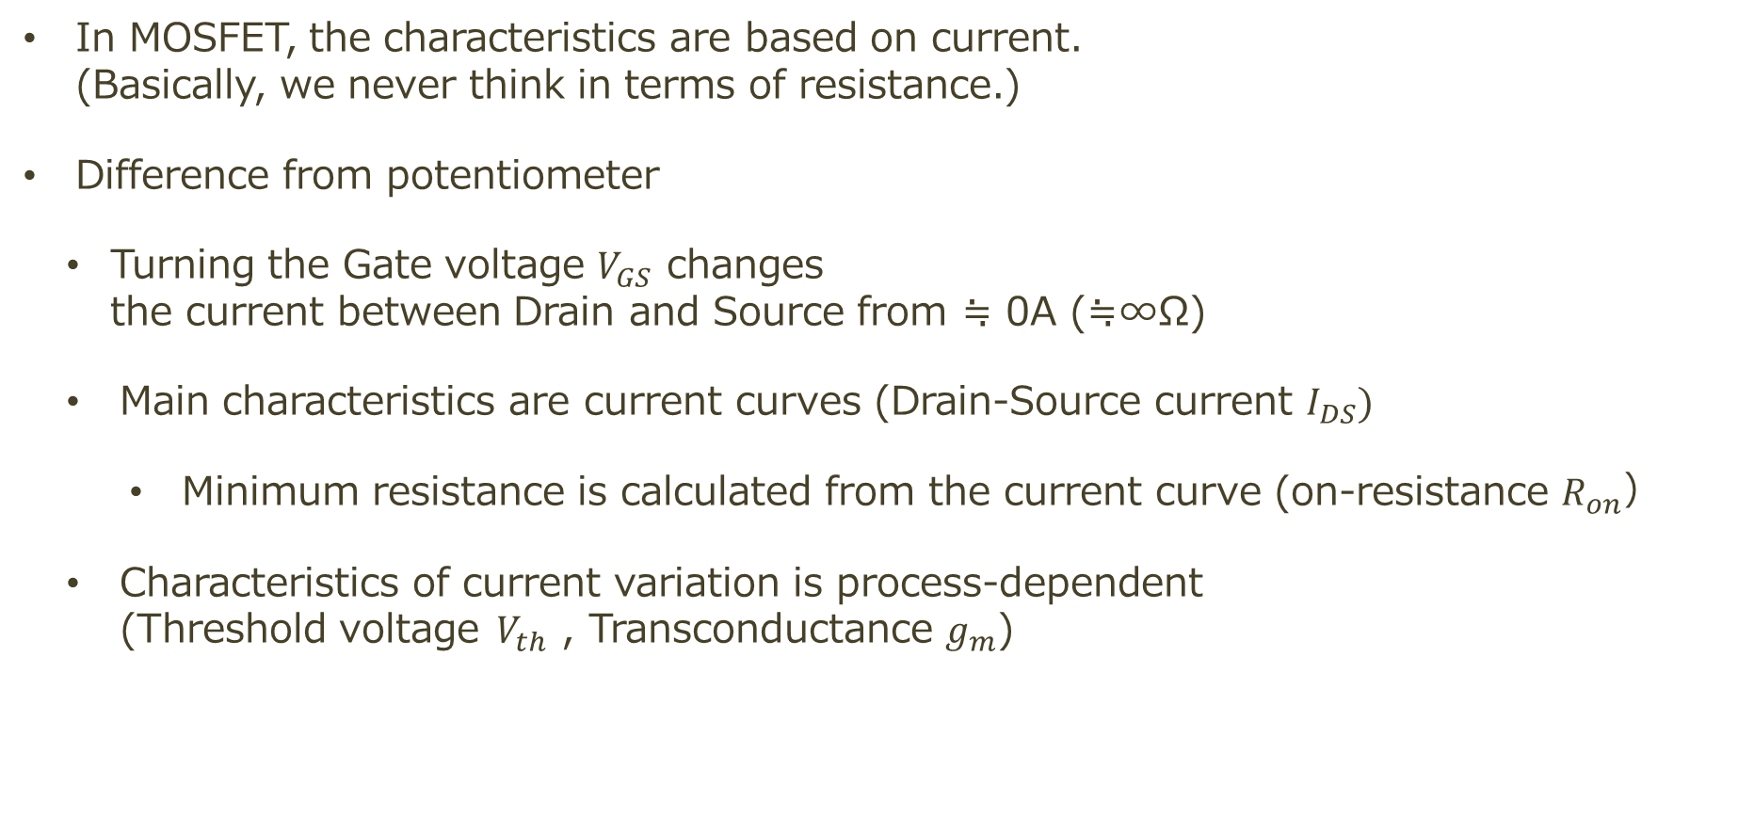
What is the MOSFET?
In MOSFET, the characteristics are based on current. (Basically, we never think in terms of resistance.)
Difference from potentiometer
Turning the Gate voltage $V_{GS}$ changes the current between Drain and Source from ≒ 0A (≒∞Ω)
Main characteristics are current curves (Drain-Source current $I_{DS})$
Minimum resistance is calculated from the current curve (on-resistance $R_{on}$）
Characteristics of current variation is process-dependent (Threshold voltage$V_{th}$ , Transconductance $g_{m}$)

Slide 10
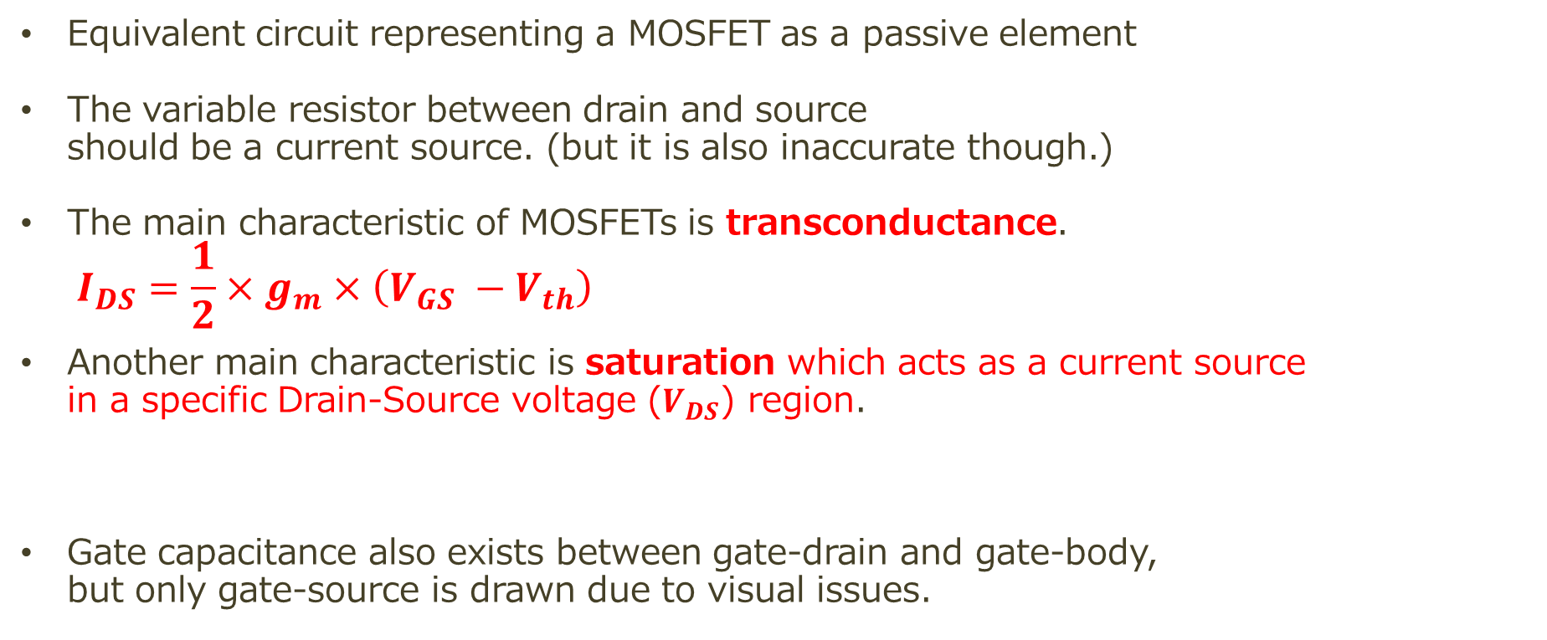
What is the MOSFET?
Equivalent circuit representing a MOSFET as a passive element
The variable resistor between drain and source should be a current source. (but it is also inaccurate though.)
The main characteristic of MOSFETs is transconductance. $I_{DS}=\frac{1}{2}×g_{m}×\left(V_{GS} −V_{th}\right)$
Another main characteristic is saturation which acts as a current source in a specific Drain-Source voltage ($V_{DS}$) region.
Gate capacitance also exists between gate-drain and gate-body, but only gate-source is drawn due to visual issues.

Slide 11
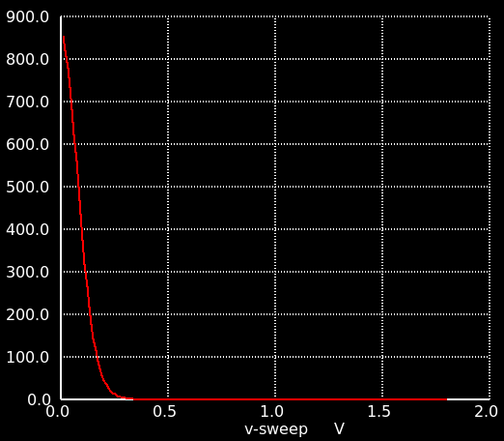
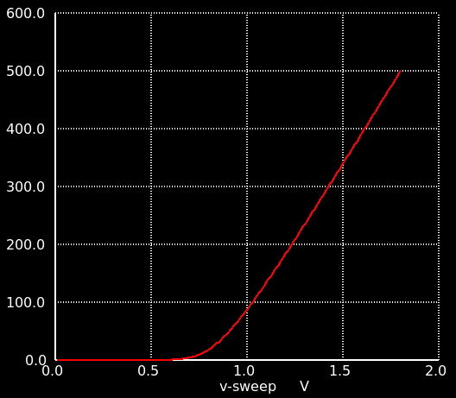




Potentiometer vs. nMOS
Hard to see if the vertical axis is in Ω
Engineers are interested in this section.
$R_{DS}$（GΩ）
$I_{DS}$（μA）
$V_{GS}$（V）
$V_{GS}$（V）

Slide 12

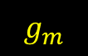
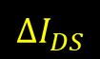
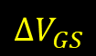
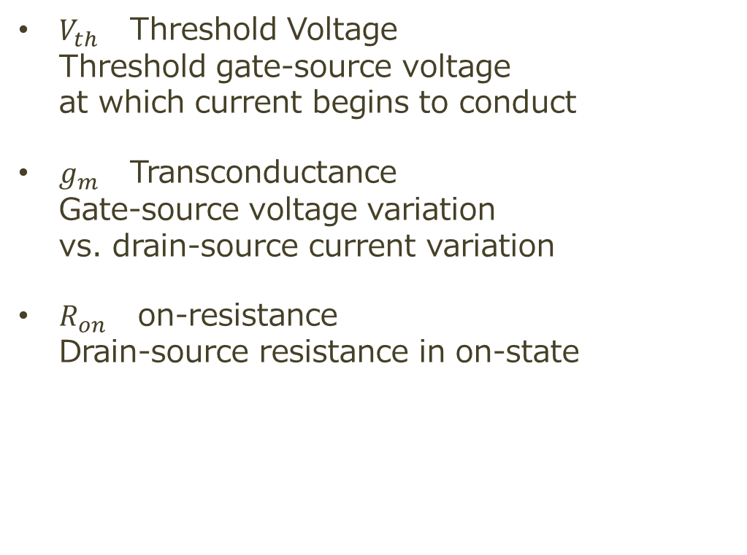
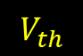

Characteristics of nMOS
$V_{th}$ Threshold Voltage Threshold gate-source voltage at which current begins to conduct
$g_{m}$ Transconductance Gate-source voltage variation vs. drain-source current variation
$R_{on}$ on-resistance Drain-source resistance in on-state
$$R_{on}$$
$$g_{m}$$
$I_{DS}$（μA）
$$ΔI_{DS}$$
$$V_{th}$$
$$ΔV_{GS}$$
$V_{GS}$（V）

Slide 13
Design flow of Analog LSI
How to design Analog LSI

Slide 14
Design flow of Analog LSI
Draw schematics and test benches
Simulation
Draw layouts based on schematics
Layout verification
Post-layout simulation: Simulation with parasitic components
（Place on frame）

Slide 15
Draw the schematics and test benches

Slide 16
Simulate

Slide 17
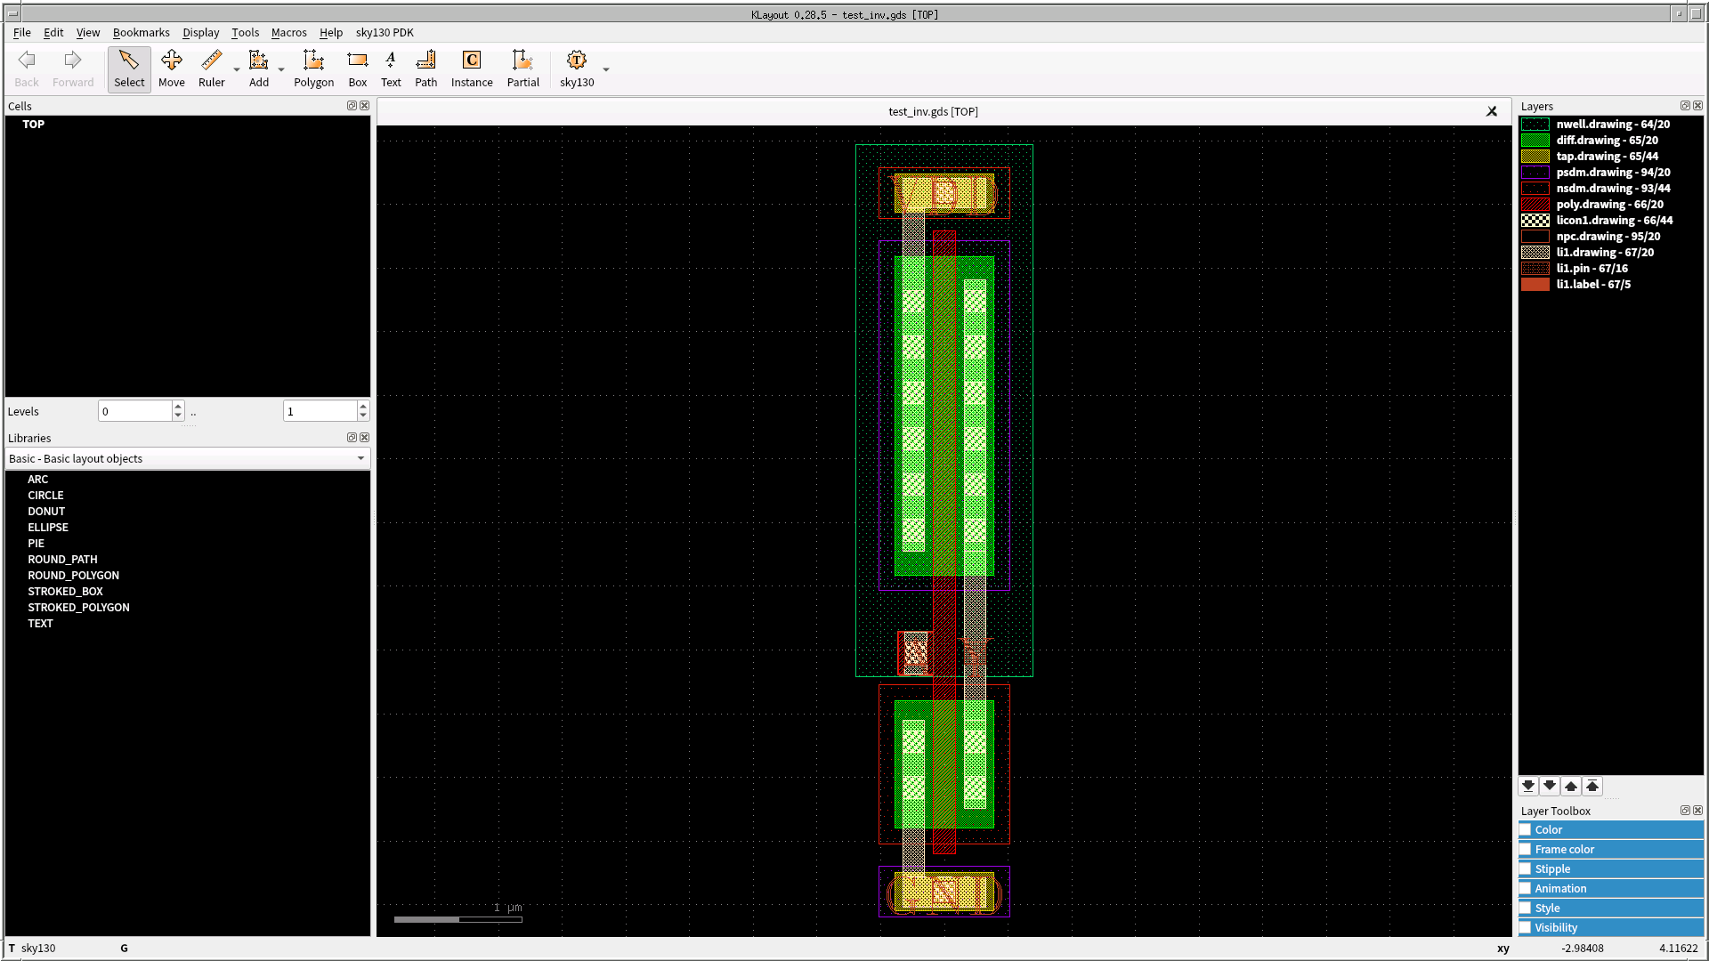
Draw the layouts

Slide 18
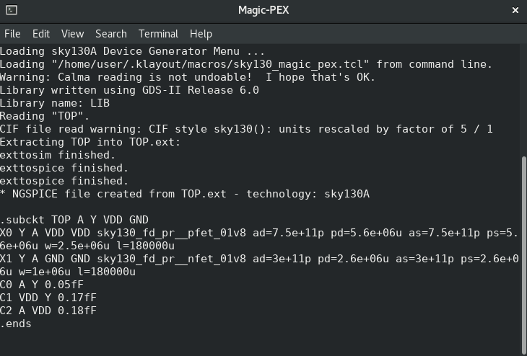
Extract parasitic components

Slide 19
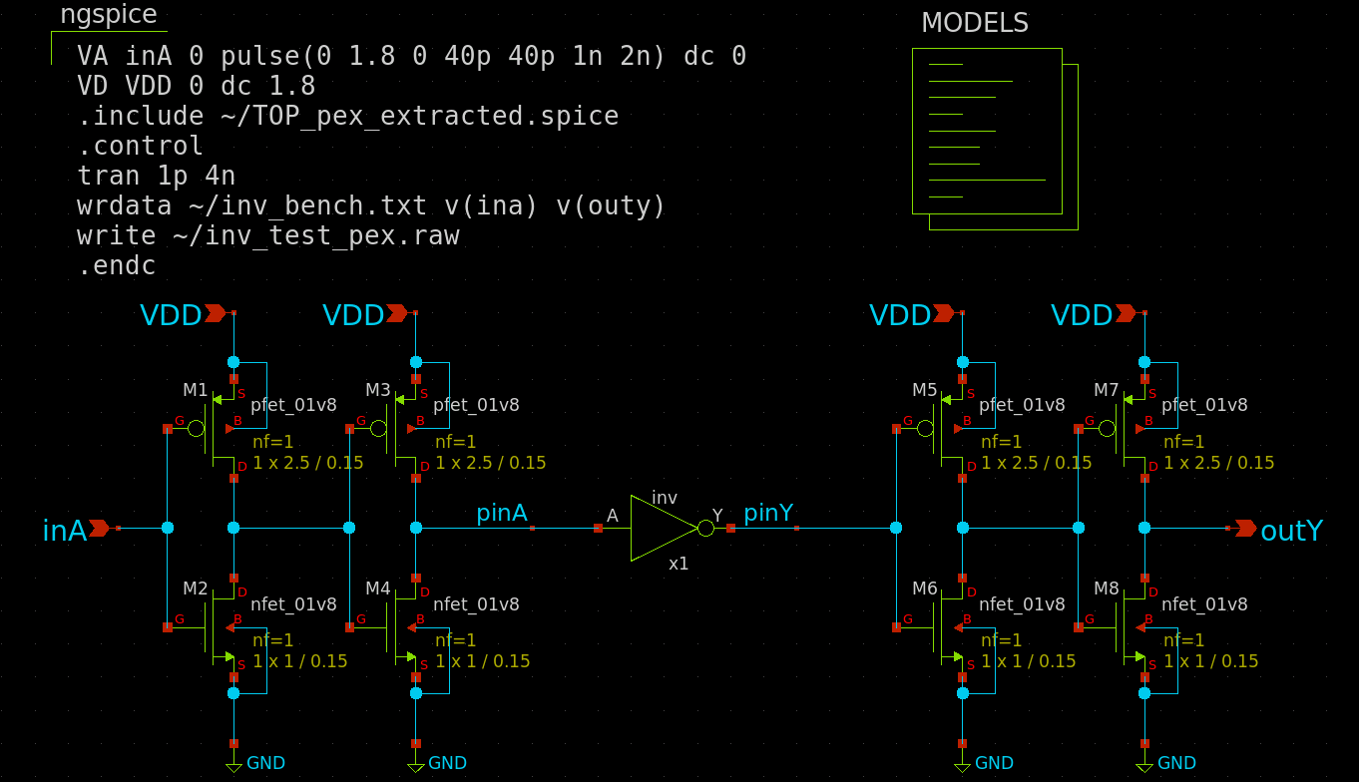
Make test benches again

Slide 20
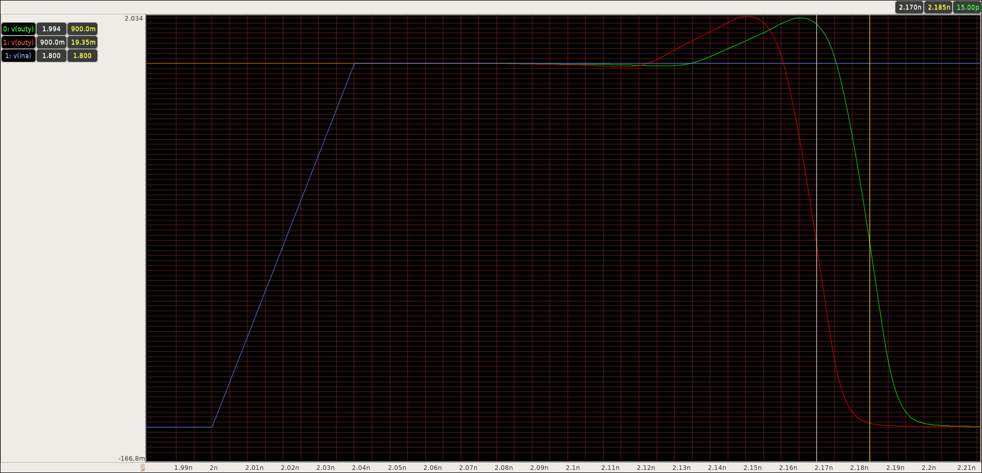
Simulate with parasitic components (Post-layout simulation)
Before
After
149.9ps
15.0ps
164.9ps
Parasitic capacitance worsens responsiveness

Slide 21
Background knowledge of LSI
Know the characteristics of the process

Slide 22
Before designing...
We want to know the characteristics of CMOS!
Vgs – Ids curve
Operational Point analysis
Vds – Ids curve

Slide 23
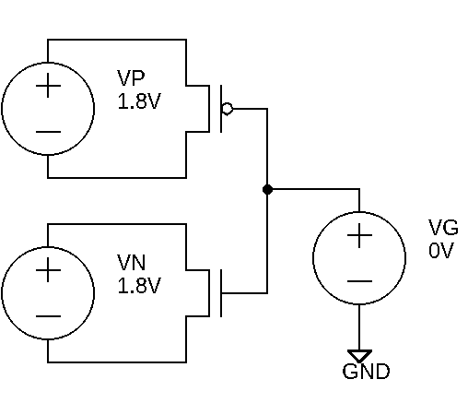
Vgs – Ids curve / on-resistance measurement
Simulate the on-resistance of CMOS (L=0.15μm, W=1.0μm, Vds=1.8V)
1. Place voltage sources vp (V=1.8) and vn (V=1.8) between drain and source 2. Place voltage source vg(V=0) between gate and GND 3. Sweep the voltage of vg between 0V and 1.8V by DC analysis 4. Find current consumption of voltage sources vp and vn
Format of DC anaylsis dc [voltage source] [start voltage] [end voltage] [step width]
Current consumption of voltage sources ngspice: vp#branch, vn#branch or gaw(waveform viewer): i(vp), i(vn)

Slide 24
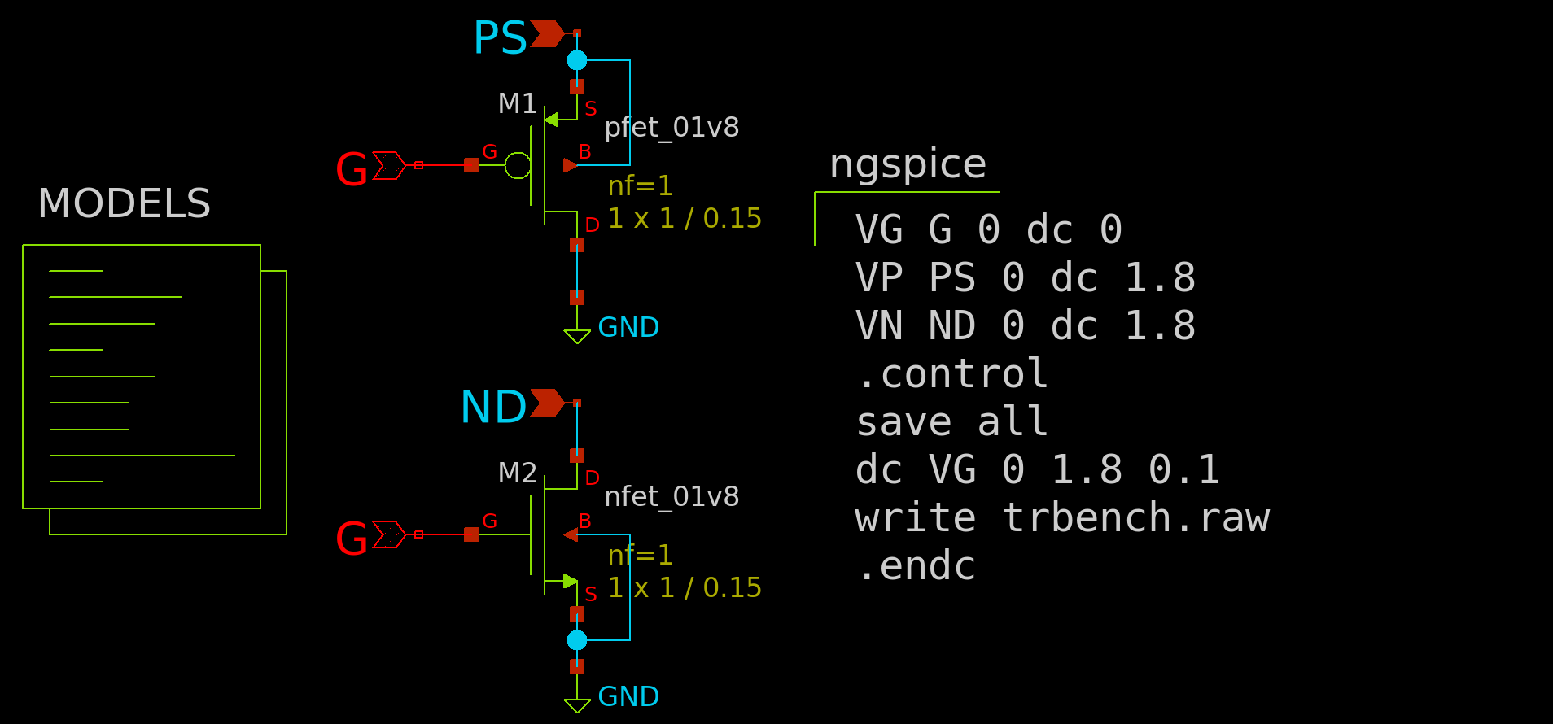
Example of test bench (L=0.15μm)
vgsbench.sch
GND is zero (0) in the SPICE netlist
Be sure to include GND or 0 as a reference.
“VSS” is not converted to 0

Slide 25
Simulation results
> plot vp#branch vn#branch

Slide 26
Output data
wrdata command saves specific data *) hoge#branch -> current consumption of voltage source hoge
vp.txt
0.00000000e+00 -2.00726126e-04
1.00000000e-01 -1.76783868e-04
2.00000000e-01 -1.52856174e-04
3.00000000e-01 -1.29370810e-04
4.00000000e-01 -1.06779404e-04
5.00000000e-01 -8.55349063e-05
6.00000000e-01 -6.60656564e-05
7.00000000e-01 -4.87492484e-05
8.00000000e-01 -3.38904626e-05
9.00000000e-01 -2.17083481e-05
1.00000000e+00 -1.23365952e-05 1.10000000e+00 -5.82743752e-06 1.20000000e+00 -2.07958988e-06 1.30000000e+00 -5.36969830e-07 1.40000000e+00 -1.19564554e-07 1.50000000e+00 -2.81003906e-08 1.60000000e+00 -6.92577344e-09 1.70000000e+00 -1.63614705e-09 1.80000000e+00 -3.19909099e-10
vn.txt
0.00000000e+00 -2.03659312e-12 1.00000000e-01 -4.80682161e-12 2.00000000e-01 -3.99689171e-11 3.00000000e-01 -4.84302376e-10 4.00000000e-01 -5.99945693e-09 5.00000000e-01 -7.04327370e-08 6.00000000e-01 -6.97912479e-07 7.00000000e-01 -4.74592920e-06 8.00000000e-01 -1.91451559e-05 9.00000000e-01 -4.83465908e-05 1.00000000e+00 -8.87674453e-05 1.10000000e+00 -1.35141610e-04 1.20000000e+00 -1.84593052e-04 1.30000000e+00 -2.35816015e-04 1.40000000e+00 -2.88115929e-04 1.50000000e+00 -3.41048569e-04 1.60000000e+00 -3.94303222e-04 1.70000000e+00 -4.47655558e-04 1.80000000e+00 -5.00941446e-04

Slide 27
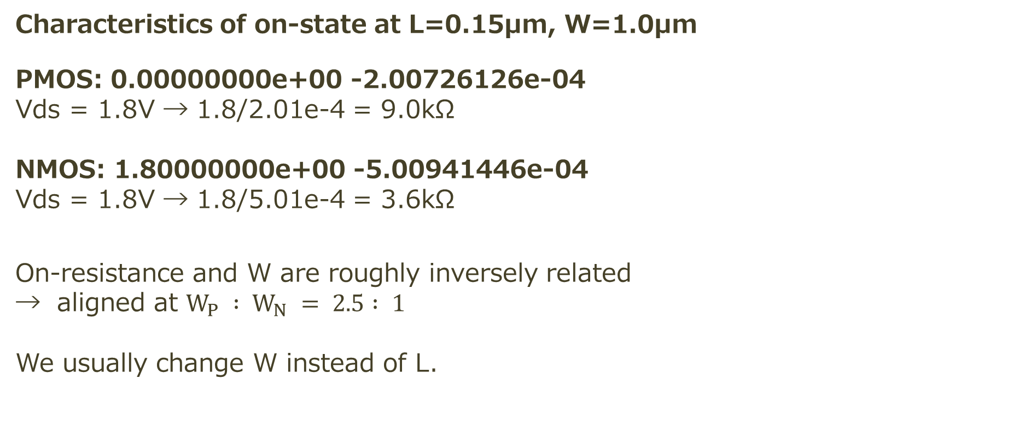
On-resistance
Characteristics of on-state at L=0.15μm, W=1.0μm
PMOS: 0.00000000e+00 -2.00726126e-04 Vds = 1.8V → 1.8/2.01e-4 = 9.0kΩ NMOS: 1.80000000e+00 -5.00941446e-04 Vds = 1.8V → 1.8/5.01e-4 = 3.6kΩ On-resistance and W are roughly inversely related → aligned at $W_{P} : W_{N} = 2.5 : 1$ We usually change W instead of L.

Slide 28
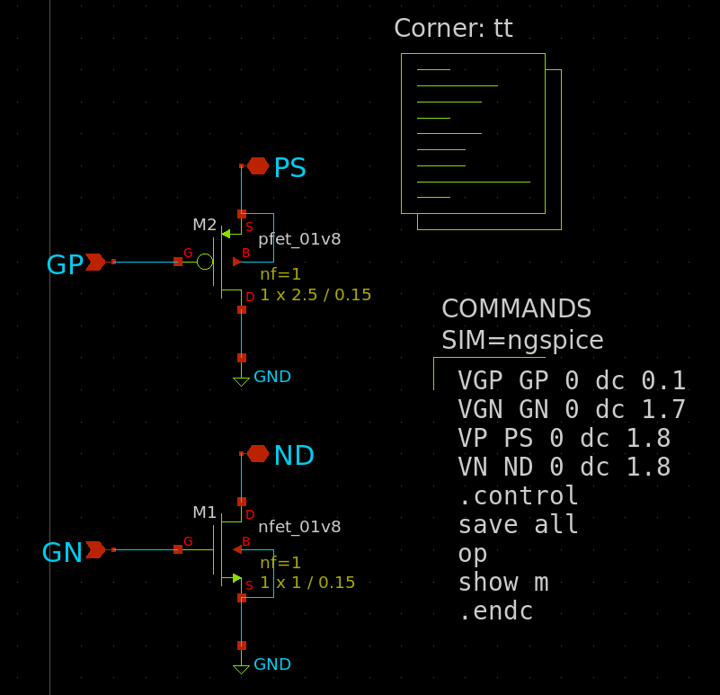
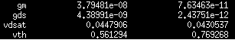
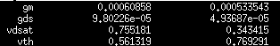
Operational Point analysis（OP）
opbench.sch
op command calculates parameters such as vth and gm.
Specify the proper voltage conditions.
gm, vdsat etc... are voltage dependent.
gm is useful for calculating currents by hand.
Off-state
On-state

Slide 29
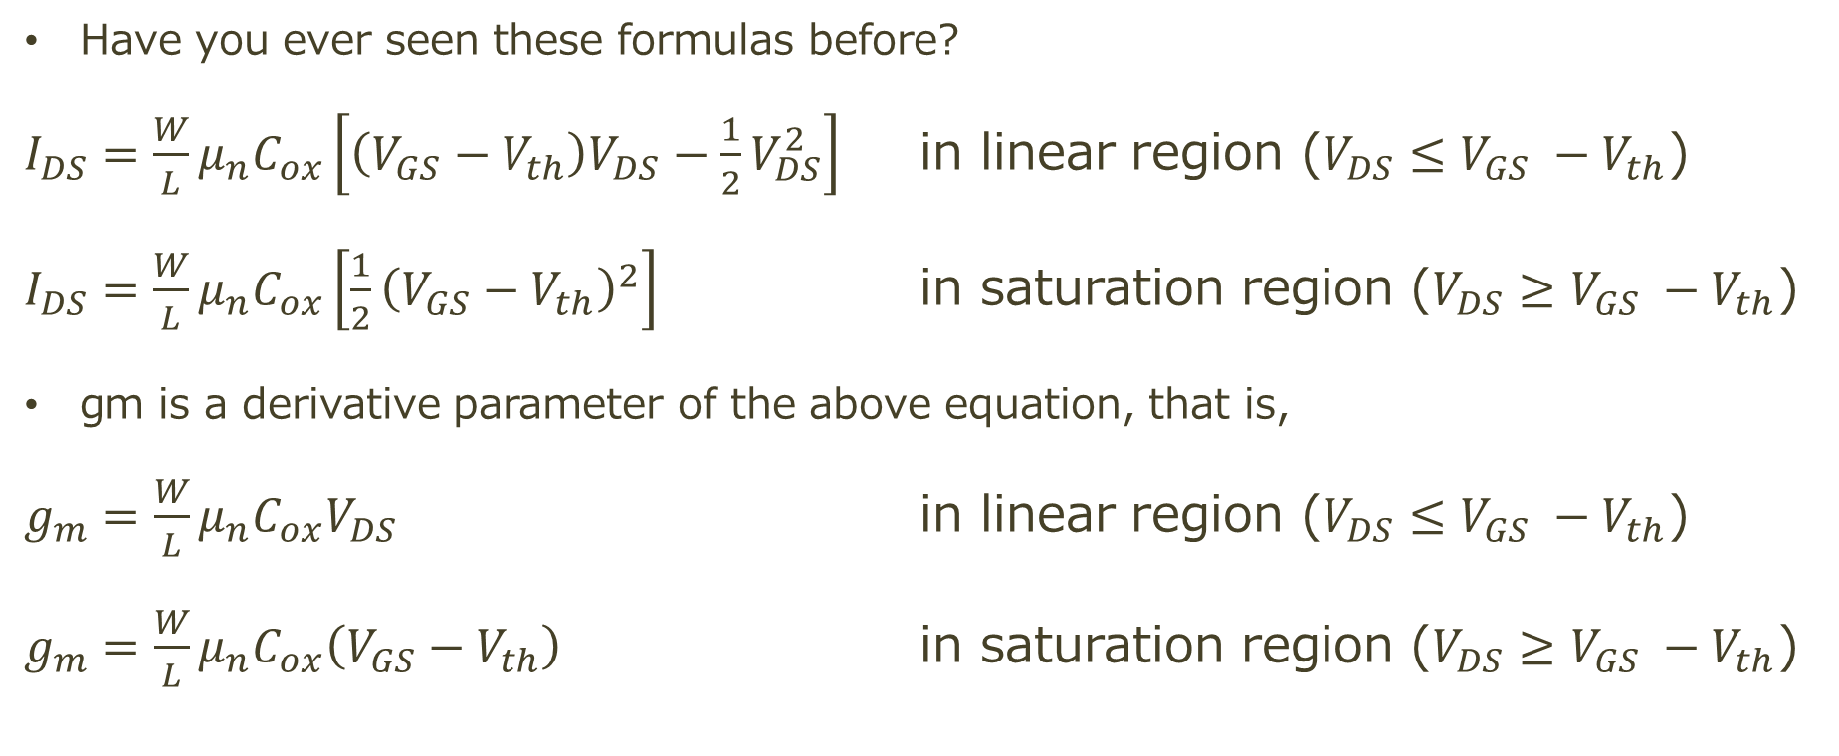
Note: transconductance gm
Have you ever seen these formulas before?
$I_{DS}=\frac{W}{L}μ_{n}C_{ox}\left[\left(V_{GS}−V_{th}\right)V_{DS}−\frac{1}{2}V_{DS}^{2}\right]$ in linear region ($V_{DS}≤V_{GS} −V_{th}$)
$I_{DS}=\frac{W}{L}μ_{n}C_{ox}\left[\frac{1}{2}{\left(V_{GS}−V_{th}\right)}^{2}\right]$ in saturation region ($V_{DS}≥V_{GS} −V_{th}$)
gm is a derivative parameter of the above equation, that is,
$g_{m}=\frac{W}{L}μ_{n}C_{ox}V_{DS}$ in linear region ($V_{DS}≤V_{GS} −V_{th}$)
$g_{m}=\frac{W}{L}μ_{n}C_{ox}\left(V_{GS}−V_{th}\right)$ in saturation region ($V_{DS}≥V_{GS} −V_{th}$)
→$I_{DS}=\frac{1}{2}×g_{m}×\left(V_{GS} −V_{th}\right)$ in saturation region

Slide 30
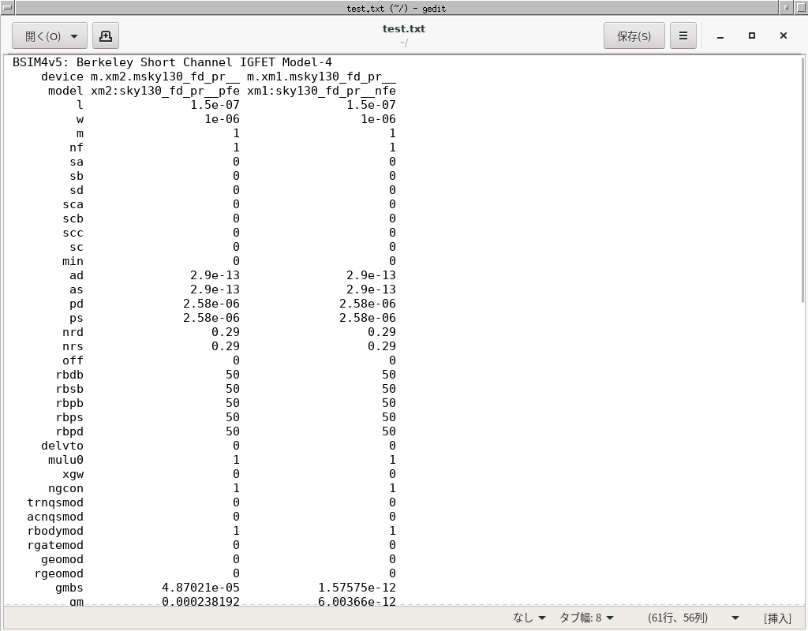
ngspice command: show m
The results can be saved to plain text.
show m > ~/test.txt

Slide 31


Parameter of transistor
Basically, we change (set) W and L
W ：Channel width
L ：Channel length *) Actual channel length is a bit short
The overlapped area of the polysilicon gate and diffusion is the “transistor” When sufficient potential is given to the gate, a channel is formed.
m, nf, mf, etc... specify the number of multi-finger gate. (Described later in the layout description)
Gate
$$L$$
Drain
Source
Almost Channel
$$W$$

Slide 32
nMOS diagram
G
D
S
n+
n+
p
B

Slide 33

nMOS diagram
Hole on substrate moves to gate at Vg > 0
→formation of deplation layer
G > 0V
D
S = 0V
n
n+
n+
n
n
Since Vd > Vs,
the depletion layer on the drain side is larger than the depletion layer on the source side
$$N_{A}^{−}$$
p
B = 0V
no current yet

Slide 34
nMOS diagram
Conduction electrons become majority carriers at Vg >> 0
→Formation of inversion layer (Vth)
G >> 0V
D
S = 0V
n+
n+
n
Inversion layer is easily formed when the depletion layer is thin and difficult to form when it is thick
$$N_{A}^{−}$$
p
B = 0V
have a current

Slide 35
nMOS diagram
Conduction electrons become majority carriers at Vg >> 0
→Formation of inversion layer (Vth)
G >> 0V
D
S = 0V
n+
n+
n
Inversion layer is easily formed when the depletion layer is thin and difficult to form when it is thick
Effective channel length
$$N_{A}^{−}$$
Channel length
p
B = 0V
have a current

Slide 36
What happens if channel width W is changed?
A larger channel width results in a wider current path, which increases the drain-source current.
For transistors with the same channel length, the channel width is proportional to the drain-source current.
W
＝
2W
W

Slide 37
What happens if channel length L is changed?
The effect of the short channel effect completely changes the characteristics. Basically, Ids increases as channel length L decreases, but short-channel effects also occur...
DIBL (Drain Induced Barrier Lowering) decreases Vth for an increase in Vds.
Increasing subthreshold swing increases punch-through in subthreshold region
Leakage current increases in the off state, and Ids variation relative to Vgs variation becomes smaller (slower) → Switching characteristics deteriorate
Channel length modulation effect increases Ids variation relative to Vds variation and does not saturate (The current is not constant on the Vds - Ids curve.)

Slide 38
Vds – Ids curve
Get the Vds - Ids curve of NMOS and see the effect of channel length modulation effect
Under construction!

Slide 39
Demonstration of Analog LSI design
Make a CMOS inverter

Slide 40
Design flow of Analog LSI
Draw schematics and test benches
Simulation
Draw layouts based on schematics
Layout verification
Post-layout simulation: Simulation with parasitic components
（Place on frame）

Slide 41
Design of CMOS inverter
Topology verification
What is the performance of CMOS inverter?
Elmore delay model
Input / Output conditions
Delay time simulation
meas command
Model corner simulation

Slide 42
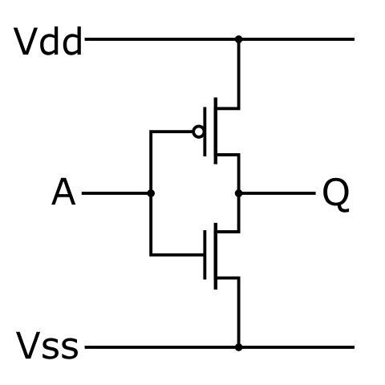
CMOS inverter, NOT logic gate
Input A | Output Q
L | H
H | L
Input A | Output Q
Vss | Vdd
Vdd | Vss
https://commons.wikimedia.org/wiki/File:CMOS_Inverter.svg

Slide 43
Logic verification（Topology verification)
In a CMOS inverter, the output should be inverted with the input
Input = 0 V → Output = Vdd V, Input = Vdd V → Output = 0 V
See how a CMOS inverter works with DC analysis
DC analysis Steady-state response when voltage is varied
tran analysis Transient response when time is varied
AC analysis Steady-state response when frequency is varied

Slide 44
Example of test bench (L=0.15μm)
inv_dc.sch

Slide 45
Simulation results
Input A=0V vs. Output Y=1.8V
Input A=1.8V vs. Output Y=0V
→It works as a CMOS inverter!

Slide 46
What is the performance of logic gate, CMOS inverter?
Topology has been determined but the size of CMOS have not yet been determined. → How to determine?
Performance of logic gate
Drivability (output current）
fan-out (F.O.)
delay time（rise delay / fall delay）

Slide 47
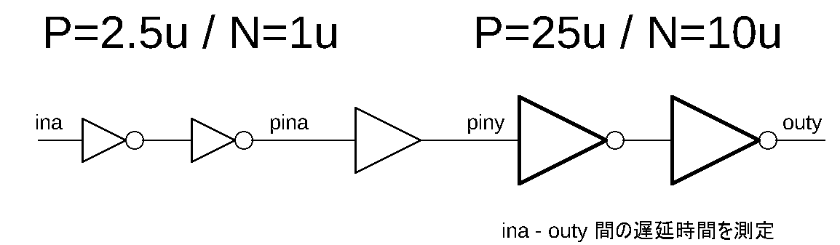
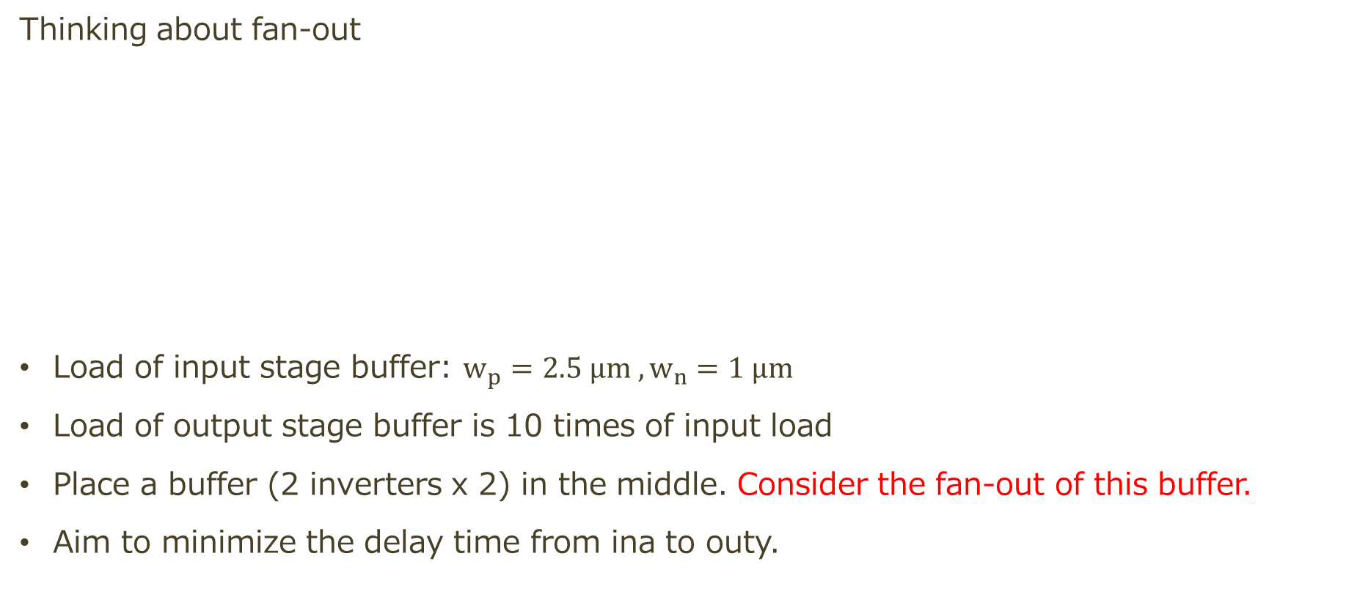
Fanout: Inverter/buffer delay
Thinking about fan-out
Load of input stage buffer: $w_{p}=2.5 μm , w_{n}=1 μm$
Load of output stage buffer is 10 times of input load
Place a buffer (2 inverters x 2) in the middle. Consider the fan-out of this buffer.
Aim to minimize the delay time from ina to outy.
Find the delay time between ina to outy

Slide 48
Delay time of buffer
Simulate the 6-stage inverter chain Do the transient analysis because we want to see the time vs. voltage waveforms.
Format of transient analysis
tran [time step] [analysis time]

Slide 49
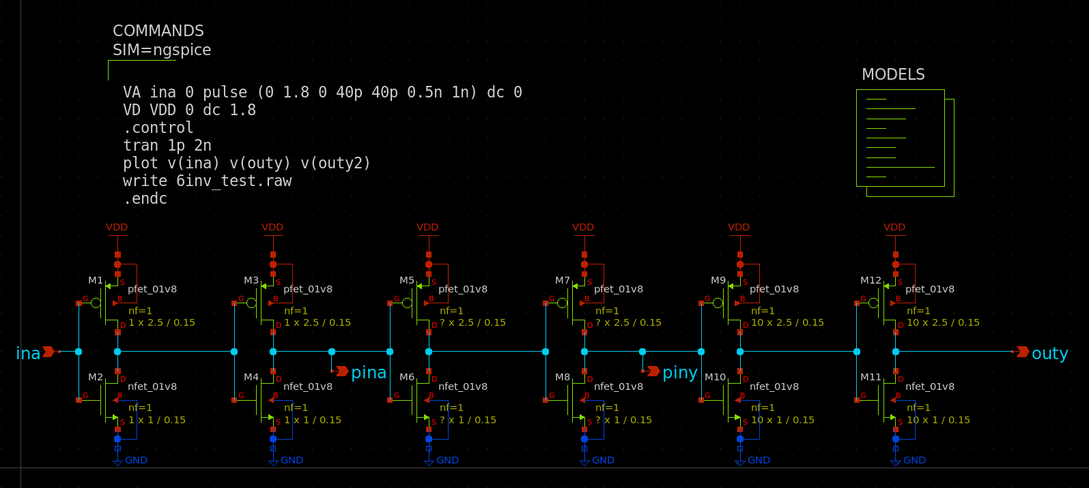
Example of testbench (L=0.15μm)
6inv_test.sch
How do you determine the fan-out here?

Slide 50
Example of testbench (L=0.15μm)
6inv_test2.sch
1→1→2→5→10→10
1→1→10→10

Slide 51
Simulation results
Buffer makes less delay

Slide 52
Note: fan-out of buffers in standard cells
buf_2 1→2
buf_4 1→4
buf_8 3→8
clkbuf8 2→8
bufbuf8 0.6→1→3→8
buf_12 4→12
buf_16 6→16
clkbuf16 4→16
bufbuf16 1→3→6→16
0.6
1
3
8
If more than 3 - 4 times, insert additional buffer(s)

Slide 53
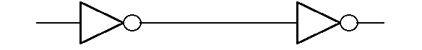
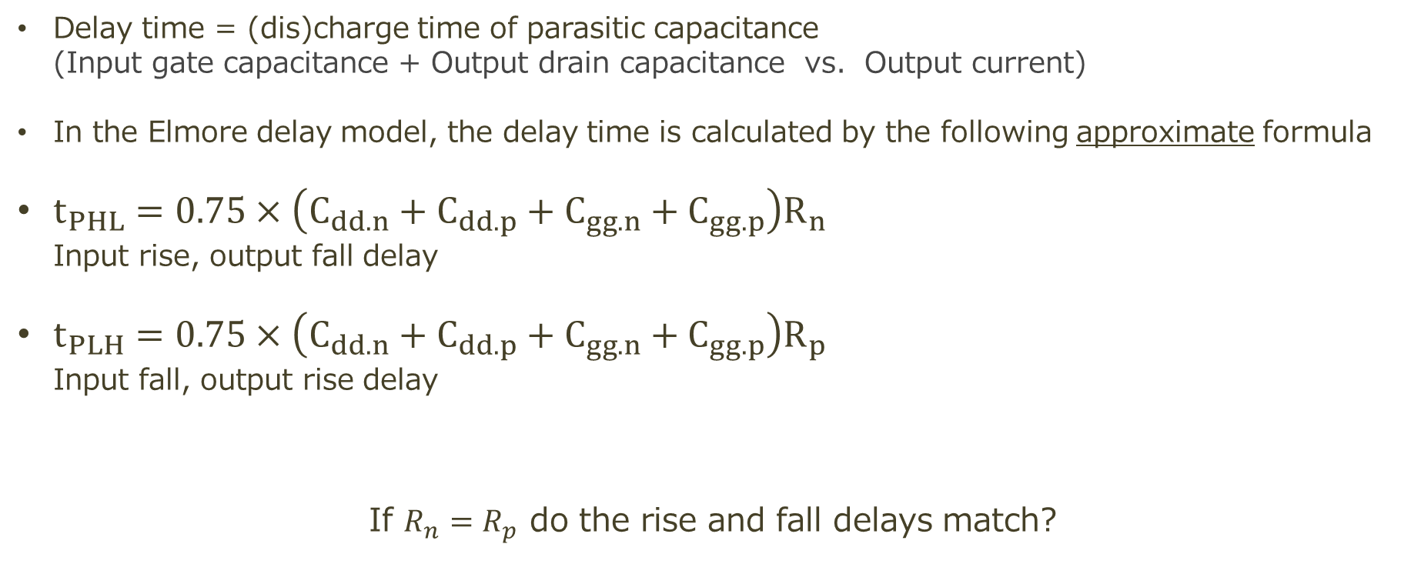
What is delay time?
RC time constant of 0.75 and a fixed resistance value
Delay time = (dis)charge time of parasitic capacitance (Input gate capacitance + Output drain capacitance vs. Output current)
In the Elmore delay model, the delay time is calculated by the following approximate formula
$t_{PHL}=0.75×\left(C_{dd.n}+C_{dd.p}+C_{gg.n}+C_{gg.p}\right)R_{n}$ Input rise, output fall delay
$t_{PLH}=0.75×\left(C_{dd.n}+C_{dd.p}+C_{gg.n}+C_{gg.p}\right)R_{p}$ Input fall, output rise delay
If $R_{n}=R_{p}$ do the rise and fall delays match?
Cdd = drain capacitance on output side Cgg = gate capacitance on input side R = on-resistance on output side

Slide 54
Cdd, Cgg can be simulated by op analysis
You may find the following formula on the internet MOSFET Input capacitance (Ciss): Ciss = Cgs + Cgd
In LSI CMOS, gate-to-body capacitance must be considered too. Cgg = |Cgs + Cgd + Cgb|
Gate capacitance is represented by the parameter Cgg
Output capacitance = Drain capacitance Cdd = |Cdg + Cds + Cdb|
Cgd and Cdg both represent drain-gate parasitic capacitance. Cdg is the parasitic capacitance that is affected when the drain voltage changes. Cgd is the parasitic capacitance that is affected when the gate voltage changes. Usually, Cdg ≠ Cgd
To find the input / output capacitance, see Cgg / Cdd in op analysis

Slide 55
Transient response, delay time
Use transient (tran) analysis if you want to find the delay time
To obtain the correct transient response (delay), set the loads on the input and output stages. (load = logic gate; usually, CMOS buffer)
Assuming we design a CMOS inverter with FO=1, we connect buffers of the same size.

Slide 56
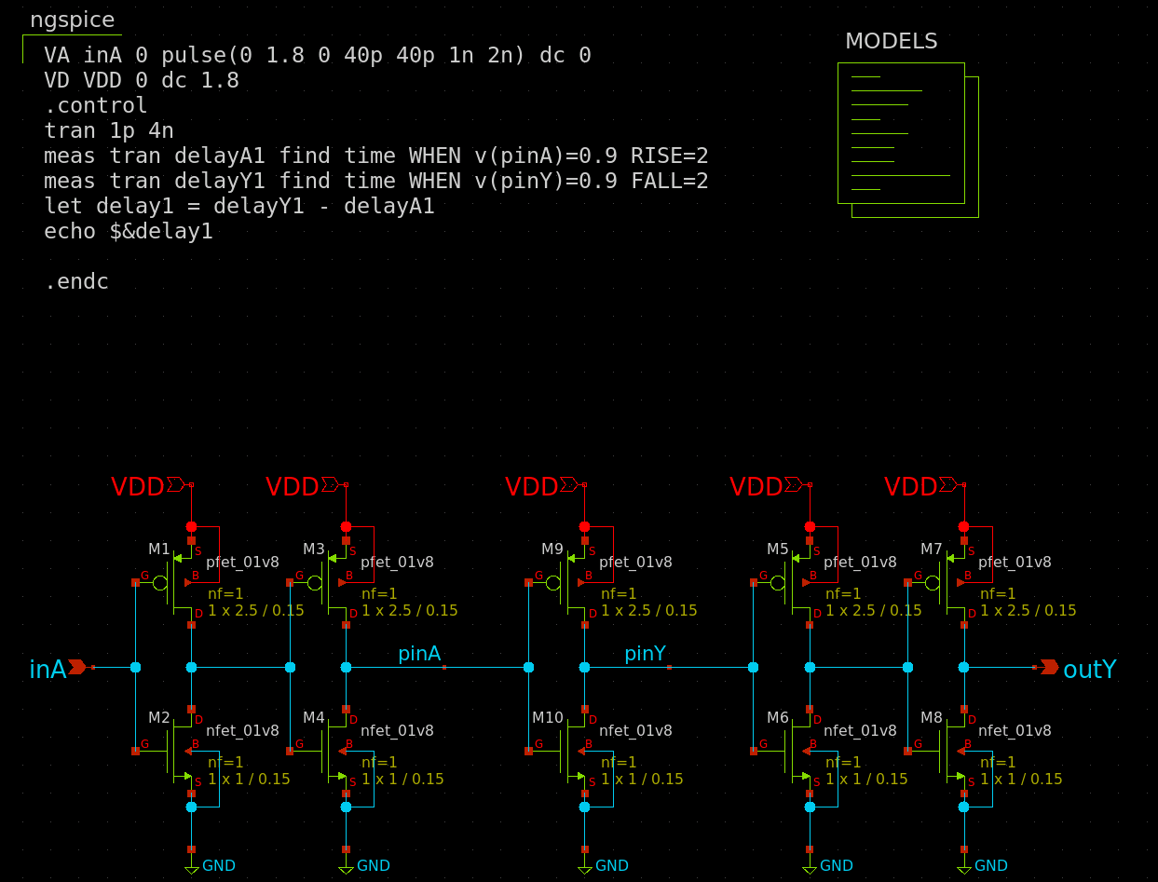
Example of test bench
inv_meas.sch

Slide 57
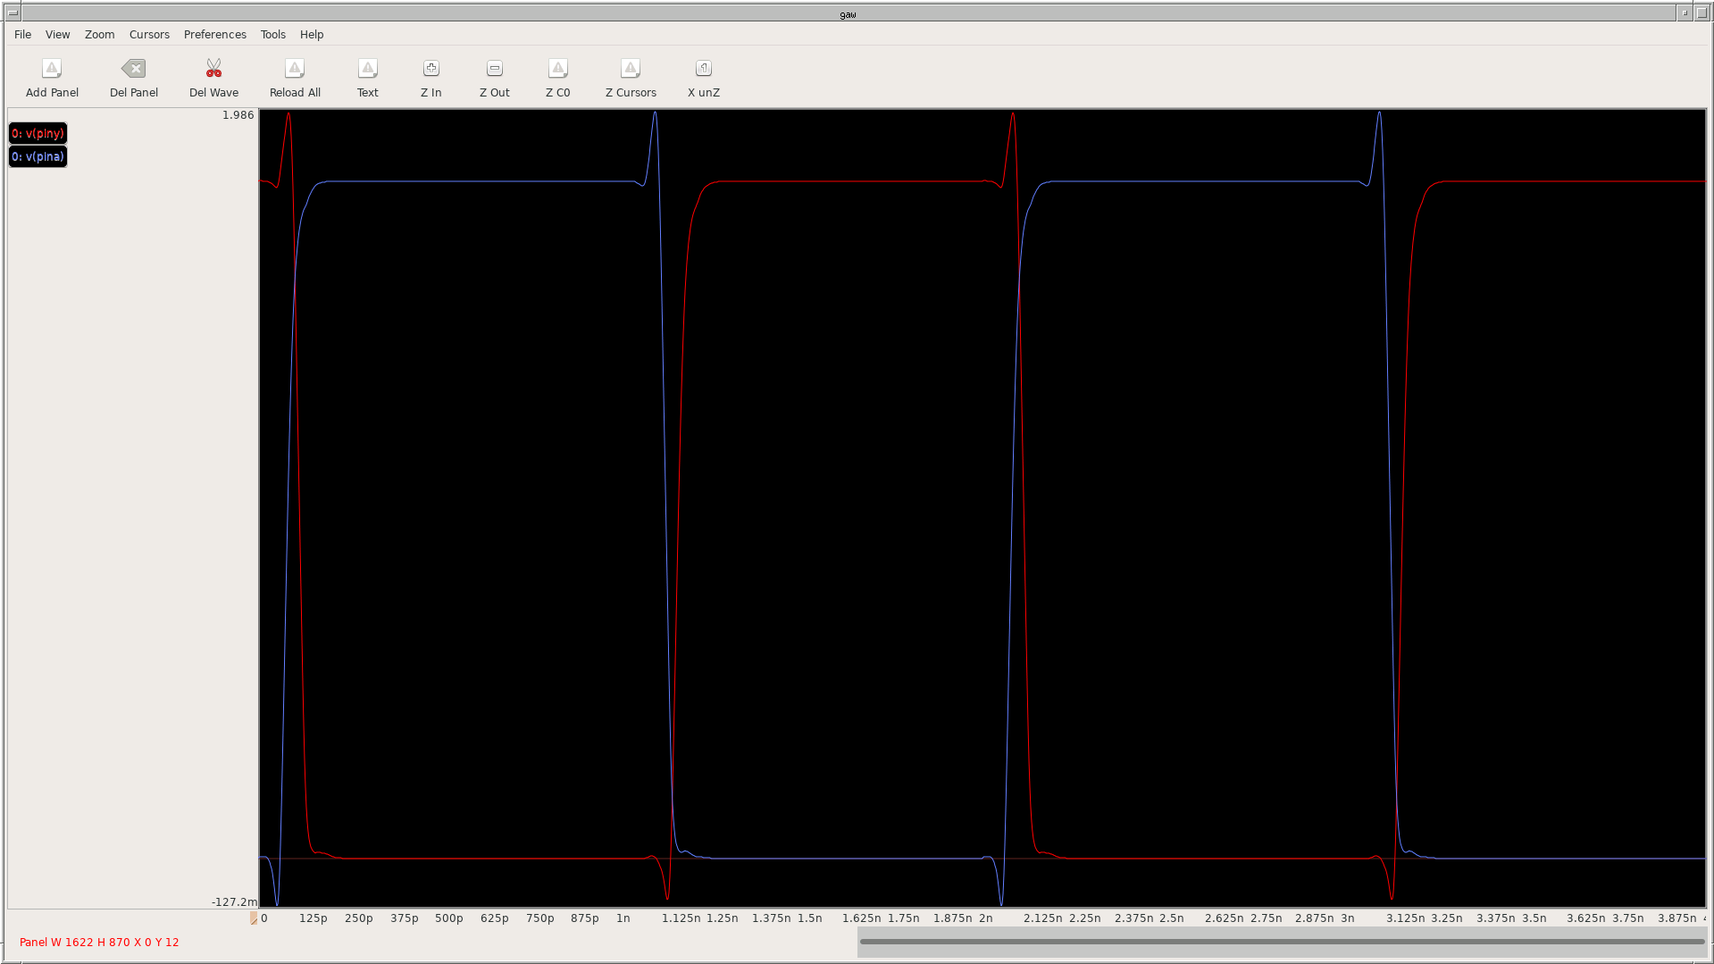
Measuring delay time with waveform viewer
Find this output fall delay time

Slide 58
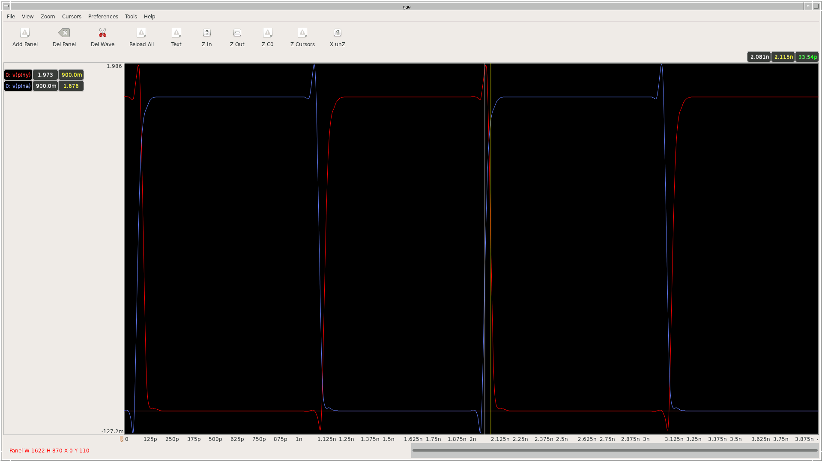
Measuring delay time with waveform viewer
Input (rise 0.9V) 2.081ns
Output (fall 0.9V) 2.115ns
Difference 33.54ps

Slide 59
Measuring delay time with commands
Find this output fall delay time
Input: second rise
Output: second fall

Slide 60
meas command
Calculating delay time from waveforms and graphs is bothersome → meas
This command is multifunctional, but this time we will focus on delay time calculation.
Format of meas command
meas tran [variable] FIND time WHEN [condition] [command]
[variable] – to assign the result to
[condition] – “v(net) = Vdd/2”
[command] – “[RISE / FALL / CROSS] = [number of count]”

Slide 61
meas command
Calculating delay time from waveforms and graphs is bothersome → meas
This command is multifunctional, but this time we will focus on delay time calculation.
meas command example
meas tran delay1 FIND time WHEN v(vin)=0.9 RISE=2 Assign the time to delay1 when v(vin) is 0.9V at the second rise
meas tran delay2 FIND time WHEN v(vout)=0.9 FALL=2 Assign the time to delay2 when v(vin) is 0.9V at the second fall

Slide 62
Find the fall delay time with meas command
inv_meas.sch
Input: second rise
Output: second fall

Slide 63
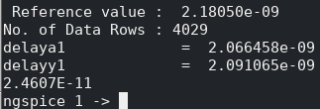
Find the fall delay time with meas command
inv_meas.sch
Input: second rise
Output: second fall
← Delay time is automatically calculated.

Slide 64
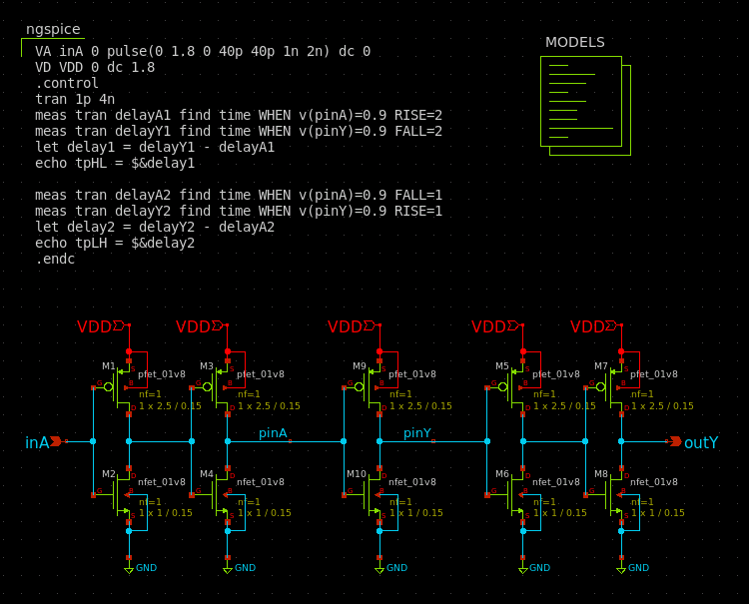
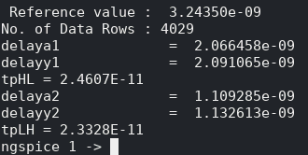
Also find the rise delay time in the same way
inv_meas.sch

Slide 65

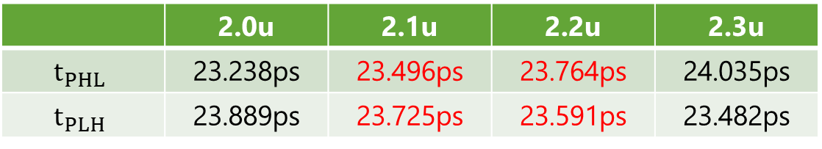
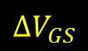
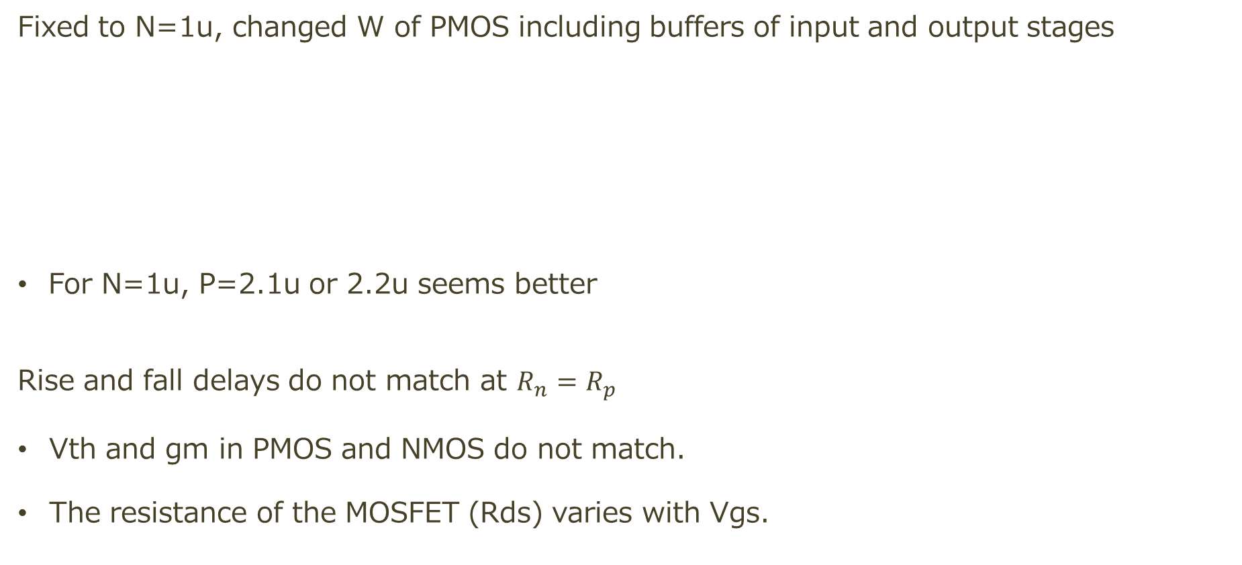
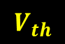



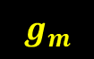
Rise times and fall times
Fixed to N=1u, changed W of PMOS including buffers of input and output stages
For N=1u, P=2.1u or 2.2u seems better
Rise and fall delays do not match at $R_{n}=R_{p}$
Vth and gm in PMOS and NMOS do not match.
The resistance of the MOSFET (Rds) varies with Vgs.
 | 2.0u | 2.1u | 2.2u | 2.3u
$$t_{PHL}$$ | 23.238ps | 23.496ps | 23.764ps | 24.035ps
$$t_{PLH}$$ | 23.889ps | 23.725ps | 23.591ps | 23.482ps
$$R_{on}$$
$$g_{m}$$
$I_{DS}$（μA）
$$ΔI_{DS}$$
$$V_{th}$$
$$ΔV_{GS}$$
$V_{GS}$（V）

Slide 66
Corner of model
ss – Model for slow responsiveness (slow-slow)
tt – Model for typical responsiveness (typical-typical)
sf
ss
High Vth causes Slow response
tt
Vth of PMOS
ff
fs
Low Vth causes Fast response
Vth of NMOS

Slide 67
Switch of model corner
Just change “tt” to “ss”, “ff”, etc…

Slide 68
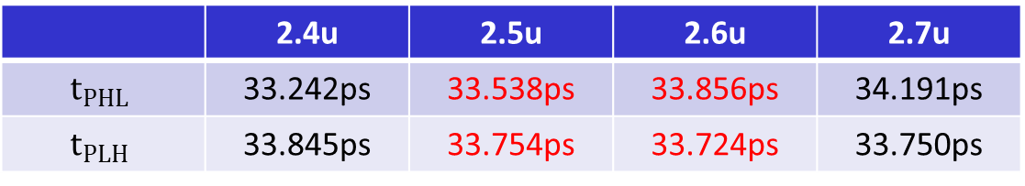
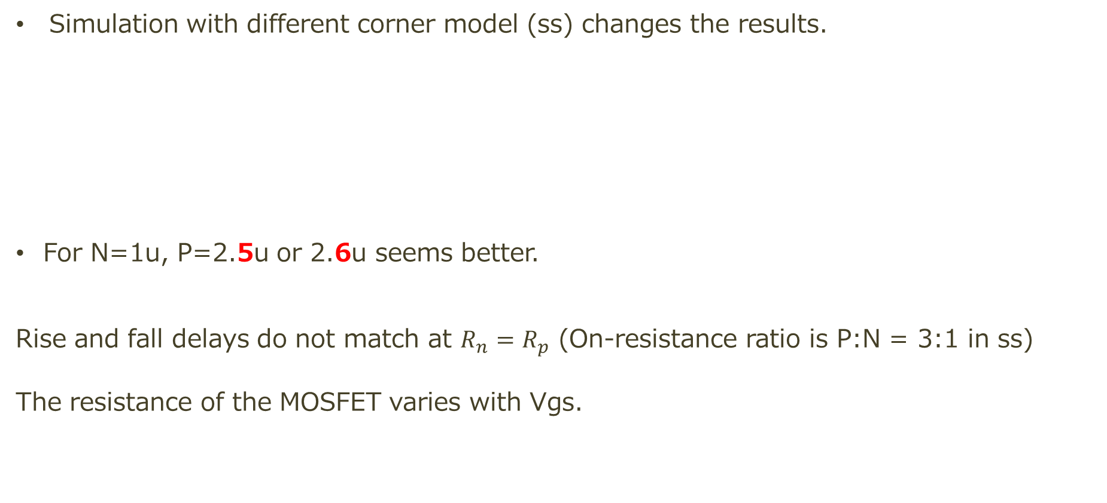
Rise times and fall times
Simulation with different corner model (ss) changes the results.
For N=1u, P=2.5u or 2.6u seems better.
Rise and fall delays do not match at $R_{n}=R_{p}$ (On-resistance ratio is P:N = 3:1 in ss) The resistance of the MOSFET varies with Vgs.
 | 2.4u | 2.5u | 2.6u | 2.7u
$$t_{PHL}$$ | 33.242ps | 33.538ps | 33.856ps | 34.191ps
$$t_{PLH}$$ | 33.845ps | 33.754ps | 33.724ps | 33.750ps

Slide 69
Background knowledge of LSI
Layout

Slide 70
Design flow of Analog LSI
Draw schematics and test benches
Simulation
Draw layouts based on schematics
Layout verification
Post-layout simulation: Simulation with parasitic components
（Place on frame）

Slide 71
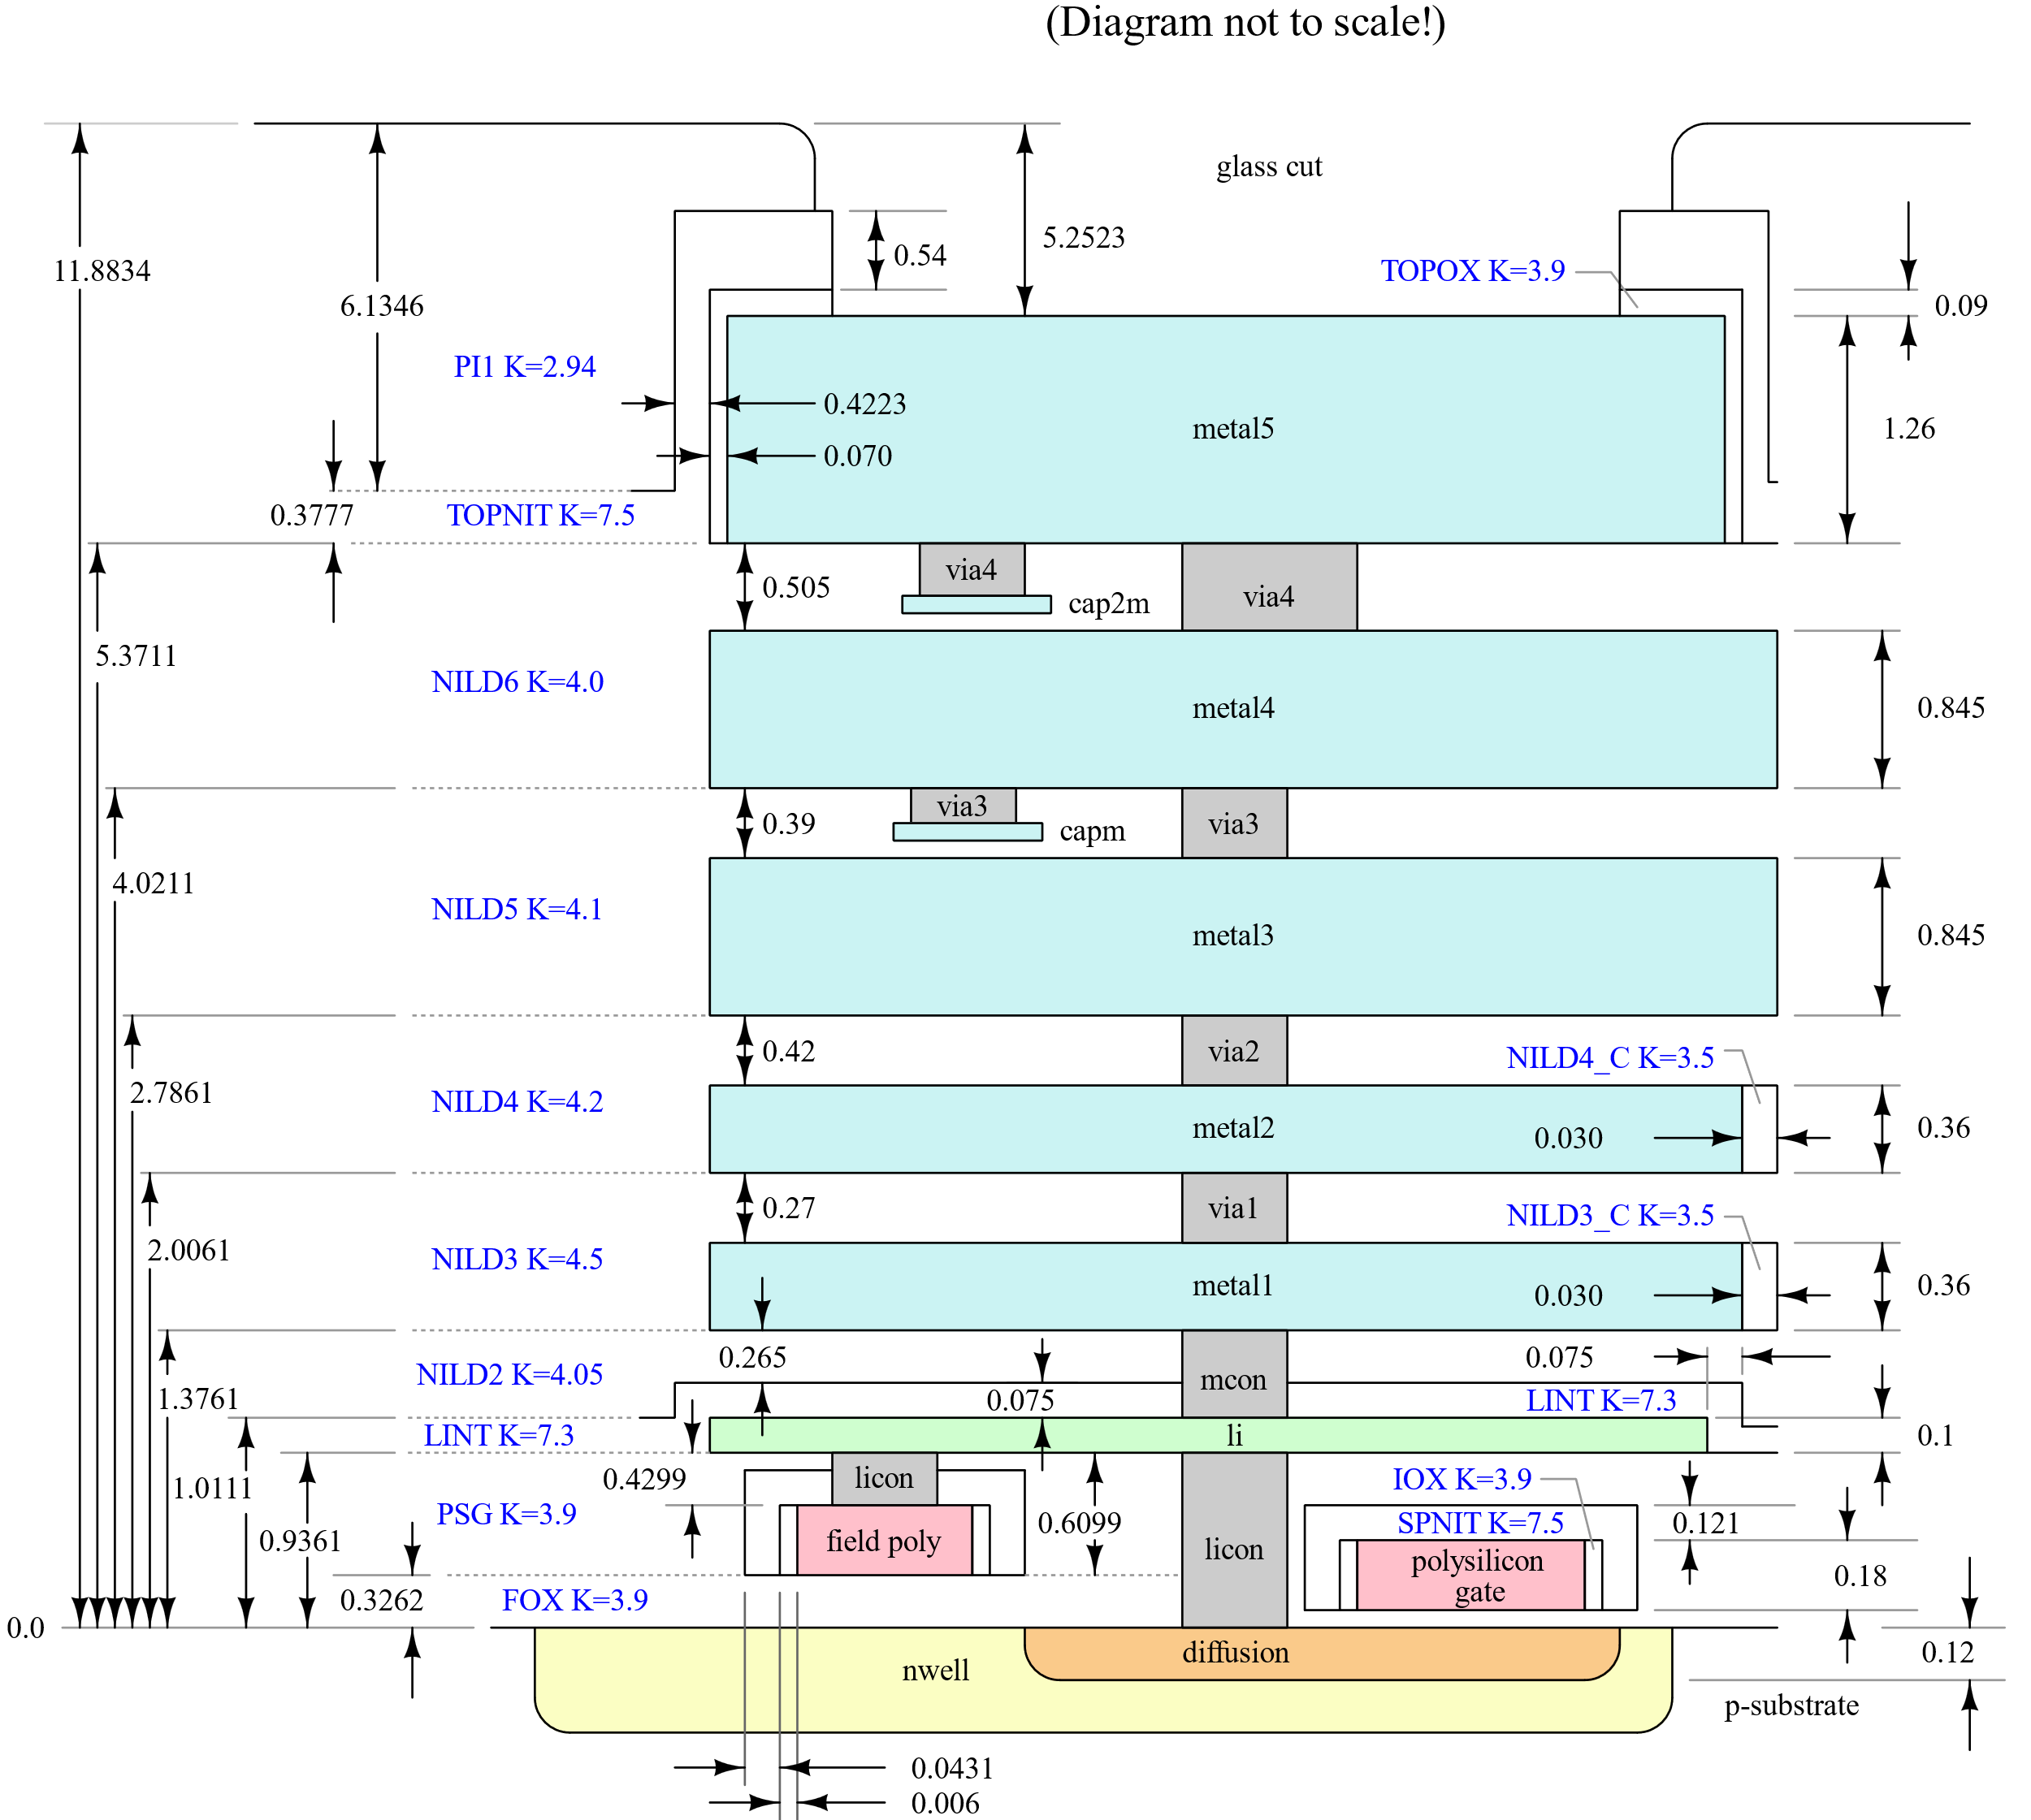
Planar MOSFET transistor
Substrate is stacked as the bottom layer.
MOSFET on substrate (well, diffusion, poly)
Wiring above the transistor(metal*, via*)
MIMCAP can be made by sandwiching an insulator between metals (metal3-capm and metal4-cap2m)

Slide 72
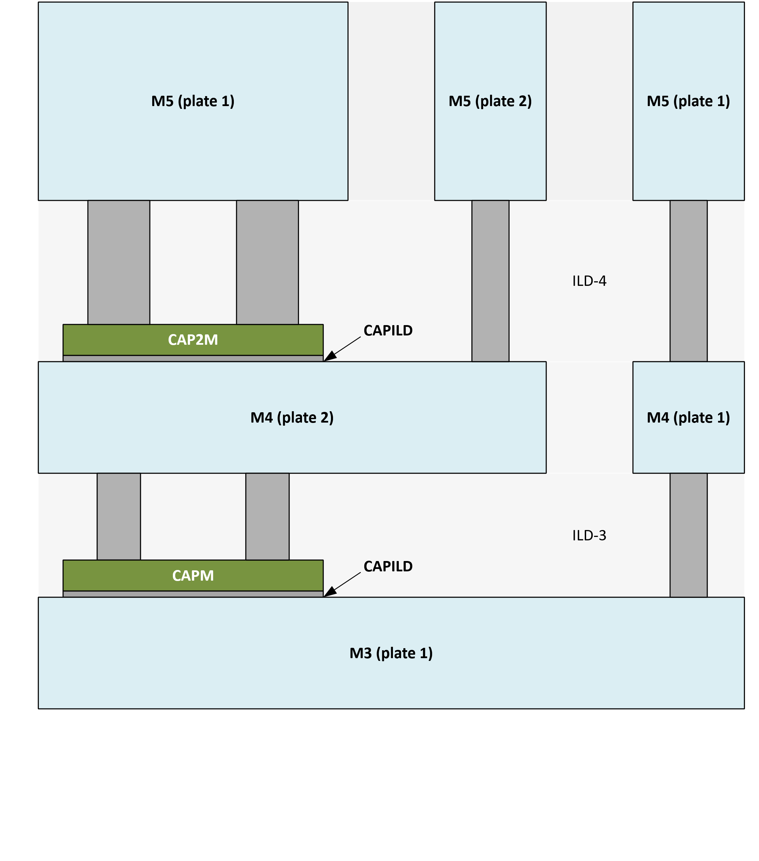
MIMCAP
2 MIMCAPs exist between M5-M4 and M4-M3
Crossed wiring layers also make a capacitor, but small capacitance. (so-called MOMCAP) →Cause of parasitic capacitance
Capacitor Consisting only of Metal1 and Metal2

Slide 73
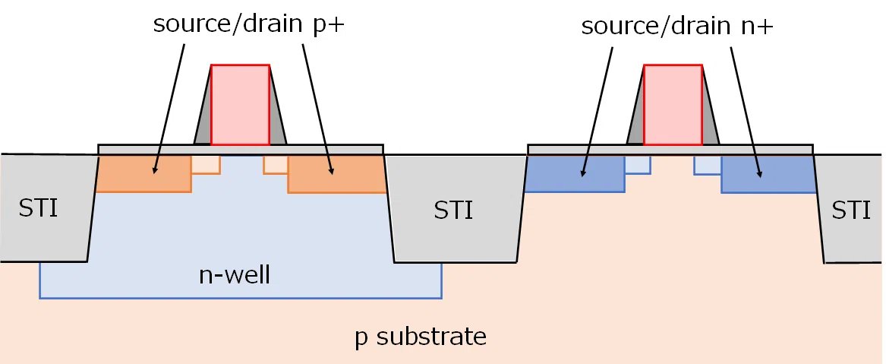
Double well, Twin well, Dual well
CMOS transistors are composed of N-well and P-substrate Pcell generates double-well CMOS by default.
PMOS has an individual well so body voltage is variable
Body of all double well NMOS are connected via substrate
(Lowest voltage in the LSI chip, GND, VSS)
https://note.com/akira_tsuchiya/n/n416b7f74b701

Slide 74
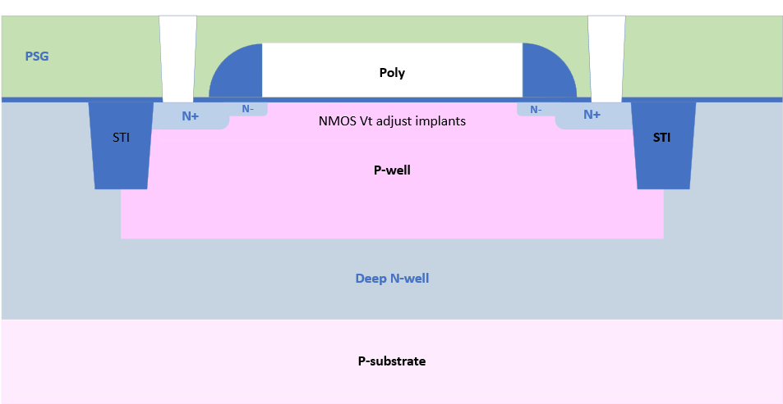
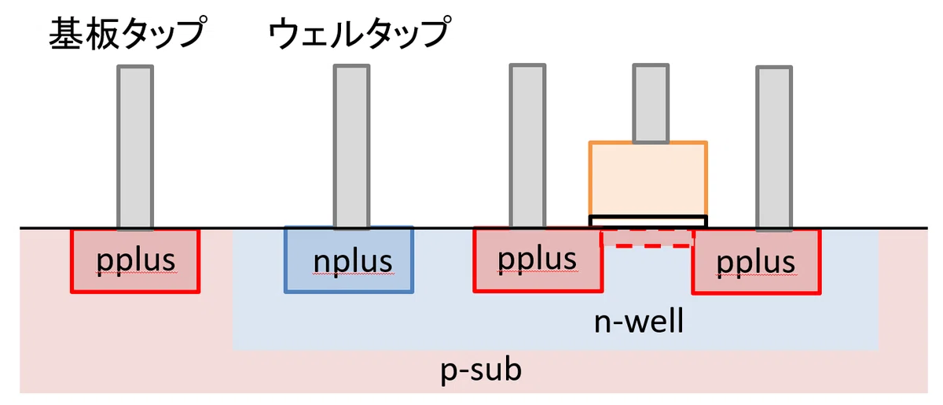

Triple well
CMOS transistors are composed of Deep N-well, P-well and N-well The cross section described in the PDK documents is triple well.
PMOS
NMOS
NMOS has an individual well so body voltage is variable
Example of applications
・Adjust Vth (body effect)
・Cascode connection with body connected to source
・Block noise from substrate
etc…
https://note.com/akira_tsuchiya/n/nd4444304f013

Slide 75
Body effect
Bias voltage applied to the body changes transistor characteristics.
Threshold voltage（Vth）varies
Drain-source current (Ids) varies (when compared with fixed gate voltage)

Slide 76
nMOS diagram
G
D
S
n+
n+
p
B

Slide 77
nMOS diagram
Hole on substrate moves to gate at Vg > 0
→formation of deplation layer
G
D
S = GND
n
n+
n+
n
n
Since Vd > Vs,
the depletion layer on the drain side is larger than the depletion layer on the source side
$$N_{A}^{−}$$
p
B=GND
no current yet

Slide 78
nMOS diagram
Conduction electrons become majority carriers at Vg >> 0
→Formation of inversion layer (Vth)
G >> 0V
D
S = 0V
n+
n+
n
Inversion layer is easily formed when the depletion layer is thin and difficult to form when it is thick
$$N_{A}^{−}$$
p
B = 0V
have a current

Slide 79
nMOS diagram
Conduction electrons become majority carriers at Vg >> 0
→Formation of inversion layer (Vth)
G >> 0V
D
S = 0V
n+
n+
Inversion layer is easily formed when the depletion layer is thin and difficult to form when it is thick
$$N_{A}^{−}$$
p
B < 0V
hard to conduct
When Vb < 0, the depletion layer spreads
→ Inversion layer becomes harder to form (Vth increases) and thinner (on-resistance increases)

Slide 80

nMOS diagram
Conduction electrons become majority carriers at Vg >> 0
→Formation of inversion layer (Vth)
G >> 0V
D
S = 0V
n+
n+
Inversion layer is easily formed when the depletion layer is thin and difficult to form when it is thick
$$N_{A}^{−}$$
p
B > 0V
easy to conduct
When Vb > 0, the depletion layer narrows
→ Inversion layer becomes easier to form (Vth decreases) and thicker (on-resistance decreases)

Slide 81


Body effect in nMOS
trbench_body.sch
$$V_{BS} − V_{TH}$$
$$V_{BS} −I_{DS}$$

Slide 82
nMOS diagram
Conduction electrons become majority carriers at Vg >> 0
→Formation of inversion layer (Vth)
G
D
S = GND
n+
n+
Inversion layer is easily formed when the depletion layer is thin and difficult to form when it is thick
$$N_{A}^{−}$$
p
B >> 0V
Current conducts from B to S

Slide 83

nMOS diagram
Conduction electrons become majority carriers at Vg >> 0
→Formation of inversion layer (Vth)
G
D=1.8V
S = GND
n+
n+
Inversion layer is easily formed when the depletion layer is thin and difficult to form when it is thick
$$N_{A}^{−}$$
p
If drain and body are shorted, it will not function as a transistor. $$(I_{DS}≪I_{BS})$$
B = 1.8V

Slide 84


Body effect in nMOS
trbench_body.sch
$$I_{DS}≤0.62mA$$
Vth of body diode
Vth of body diode
$$V_{BS} vs V_{TH}$$
$$V_{BS} vs \left(I_{DS}+I_{BS}\right)$$

Slide 85

To apply bias voltage to the body
Since the transistor will conduct and fail if the biasing of body diode exceeds $V_{TH}$, Bias voltage is applied as long as it does not exceed that value.
Triple well is required to bias body in nMOS.
More complicated to draw and larger area than double well.
Triple-well is disadvantageous in logic circuits. The larger the area, the lower the density.
Double well is recommended if there is no preference since it is disadvantageous in terms of integration density.
Connect the body of PMOS to VDD and the body of NMOS to GND (VSS, ±0V)

Slide 86

Example: 2-input NAND
M2_B = M4_B = GND M2 can be double well
M6_B ≠ M8_B = GND M6 must be triple well

Slide 87

Planar Pch MOSFET transistor（triple well）
P+
Pshophorus-Silicate Glass; Insulators to fill in between layers
Polysilicon
Oxide insulating layer
Shallow Trench Isolation
N-well
STI avoids leakage current
・Improve withstand voltage
・Avoid latch-up (occurs in PNPN)
Deep N-well
P-substrate

Slide 88
Planar Pch MOSFET transistor
nwell N-well
diff / active Diffusion layer of different polarity from well or substrate
psdm P+ implant
poly Polysilicon
dnwell is not drawn by default. (not necessary even for triple well)
poly
diff (diffusion)
psdm (n+)
nwell

Slide 89

Planar Nch MOSFET transistor（triple well）
N+
Pshophorus-Silicate Glass; Insulators to fill in between layers
Polysilicon
Oxide insulating layer
Shallow Trench Isolation
P-well
STI avoids leakage current
・Improve withstand voltage
・Avoid latch-up (occurs in PNPN)
Deep N-well
P-substrate

Slide 90
Planar Nch MOSFET transistor
diff / active Diffusion layer of different polarity from well or substrate
nsdm N+ implant
poly Polysilicon
pwell and dnwell are not drawn by default.
poly
diff (diffusion)
nsdm (n+)

Slide 91
Planar Nch MOSFET transistor
Poly-Oxide-Diff sandwich is the M-O-S transistor.
$$L \\ 0.18μm$$
The direction of L and W is determined by the direction of current
$$W$$
$$1.0μm$$

Slide 92



Poly resistor
W/L of poly resistor is opposite to MOSFET
$$W$$
$$L \\ 0.18μm$$
$$L$$
The direction of L and W is determined by the direction of current
$$W$$
$$1.0μm$$

Slide 93
Planar MOSFET transistor（Triple well）
High voltage side is Source, low voltage side is Drain in pMOS
High voltage side is Drain, low voltage side is Source in nMOS
Gate
Gate
Deep N-well
p-substrate
Well of each transistor is a body in the triple-well.
The P-well of nMOS is isolated from the P-substrate by the Deep N-well.

Slide 94
Body connection: tap
Default PFET and NFET are 3-terminal devices and have no body terminals.
Use TAP layer to connect to the body.

Slide 95
Body connection: tap
Default PFET and NFET are 3-terminal devices and have no body terminals.
Use TAP layer to connect to the body.
* = Drain or Source
G
G
*
*
*
*
G
G
*
*
B
*
*
B

Slide 96

Body connection in Pcell
PFET is connected to N-well via N+. NFET is connected to P-substrate via P+. + indicates a high doping concentration, which has the effect of reducing contact resistance
https://note.com/akira_tsuchiya/n/nd4444304f013

Slide 97
Layer names and meanings
nwell N-well
diff Diffusion layer of different polarity from well or substrate
tap Diffusion layer of the same polarity as the well or substrate
psdm P+ implant
nsdm N+ implant
poly Polysilicon
licon1 Contact (Via) to li1 (metal layer)
npc Nitride Poly Cut (polysilicon exposed area)
li1 local interconnect (metal layer)

Slide 98
Layer names and meanings
The top of polysilicon is insulated with nitride (not PSG). npc is a nitride masking layer.
When connecting licon1 (contact to li1), it is necessary to draw npc as well.

Slide 99
Layer names and meanings

Slide 100

Layer to pass LVS check in tapless design: well.pin
When designing the layout without taps (contacts to body), well.pin can avoid body connection violations in LVS.
well.pin specifies the net name of the substrate / well. Don’t forget that you need to connect the body with tap cells.
nwell.pin
pwell.pin (even with p-substrate)

Slide 101
Layout
Layout: Planar FET

Slide 102
How to draw the layout
１．Make a LVS schematic (Xschem) ・ Delete non-schematic symbols such as power source (idc, vdc...) and commands ・ Replace Global net symbol (vdd, gnd...) with iopin.sym
２．Draw the layout ・ You should run DRC every couple of operations until you get used to it.
３．DRC(Design Rules Check) ・ If you don’t pass DRC, foundries will not make a chip.
４．LVS (Layout Versus Schematic) ・ Compare your layout with the LVS schematic and check if it is drawn correctly.
５．PEX (Parasitic Extraction)
Layout
verification

Slide 103


Example layouts of CMOS inverter (NOT logic gate)

Slide 104
Notes
Do not violate design rules https://skywater-pdk.readthedocs.io/en/main/rules/periphery.html
Run Klayout DRC (Caravel) to verify that there are no errors and no violations.
Run Klayout LVS to verify that your layout is equal to the LVS schematic.
If they do not match, post-layout simulation will not work properly. Of course, real chip may not work too.
Magic DRC/LVS is also available.

Slide 105
2-input NAND layout based on Pcell

Slide 106
Major design rules
SKY130

Slide 107
Design rules
All design rules are here
https://skywater-pdk.readthedocs.io/en/main/rules/periphery.html
Here are some important design rules for drawing CMOS inverters
Transistors are automatically generated by Pcell, so we will focus on the metal layer.

Slide 108
GRID / OFFGRID
x.1b: All layers must be on a grid of 0.005μm.
Some layers (met1, via, met2) are available down to 0.001μm (x.1a),
however, the Klayout DRC is unified at 0.005μm for all layers.
For example, when you draw the rectangle, the coordinates of 4 points must be 0.005μm steps.
OFFGRID error occurs when the coordinate finer than 0.005μm is specified

Slide 109
npc.drawing : Nitride Poly Cut
npc.1 : Minimum width : 0.270 μm
npc.2 : Minimum space of npc to npc: 0.270 μm
npc.4 : Minimum space of npc to diff/tap: 0.090 μm

Slide 110
licon1.drawing : Local Interconnect Contact
licon.1 : Contact size must be 0.170 μm×0.170 μm licon.2 : Minimum space of licon to licon: 0.170 μm
Minimum enclosure of licon by diff: licon.5a : In either one of the x,y axes : 0.040 μm licon.5c : In the other of the x,y axes : 0.060 μm
Minimum enclosure of licon by tap: licon.7 : In either one of the x,y axes : 0.120 μm licon.6 : May contact in the other axis, but must not overhang licon.5b : Min space between tap_licon and diff-abutting tap edge: 0.060μm from diff
Minimum enclosure of licon by poly: licon.8 : In either one of the x,y axes : 0.050 μm licon.8a : In the other of the x,y axes : 0.080 μm

Slide 111

li1.drawing : Local Interconnect
li.1 : Minimum space : 0.170 μm li.2 : Maximum L/W ratio without licon or mcon : 10 DRC cannot check li.2 rule li.3 : Minimum space of li to li : 0.170μm li.6 : Minimum area : 0.0561 μ$m^{2}$
Minimum enclosure of li1 by licon: li.5 : In either one of the x,y axes : 0.080 μm licon.6 :May contact in the other axis, but must not overhang

Slide 112
mcon.drawing : Metal Contact (li1 - met1)
ct.1 : Contact size must be 0.170 μm×0.170 μm ct.2 : Minimum space of mcon to mcon : 0.190 μm
Minimum enclosure of mcon by li: ct.4 : mcon must not overhang li1.drawing (0.000 μm)
Minimum enclosure of met1 by mcon: m1.4 : In either one of the x,y axes : 0.030 μm m1.5 : In the other of the x,y axes : 0.060 μm

Slide 113

met1/2/3.drawing : Metal
met1.drawing : m1.1 : Minimum width : 0.140 μm m1.2 : Minimum space of met1 to met1: 0.140 μm m1.6 : Minimum area : 0.083 μ$m^{2}$
met2.drawing : m2.1 : Minimum width : 0.140 μm m2.2 : Minimum space of met2 to met2 : 0.140 μm m2.6 : Minimum area : 0.0676 μ$m^{2}$
met3.drawing : m3.1 : Minimum width : 0.300 μm m3.2 : Minimum space of met3 to met3 : 0.300 μm m3.6 : Minimum area : 0.240 μ$m^{2}$

Slide 114
via.drawing : Via (met1 - met2)
via.1 : Contact size must be 0.150 μm×0.150 μm via.2 : Minimum space of via to via : 0.170 μm
Minimum enclosure of via by met1: via.4 : In either one of the x,y axes : 0.055 μm via.5 : In the other of the x,y axes : 0.085 μm
Minimum enclosure of met2 by via: m2.4 : In either one of the x,y axes : 0.055 μm m2.5 : In the other of the x,y axes : 0.085 μm

Slide 115
via2.drawing : Via2 (met2 – met3)
via.1 : Contact size must be 0.200 μm×0.200 μm via.2 : Minimum space of via to via : 0.200 μm
Minimum enclosure of via2 by met2: via.4 : In either one of the x,y axes : 0.040 μm via.5 : In the other of the x,y axes : 0.085 μm
Minimum enclosure of met3 by via2: m3.4 : 0.065 μm on all four sides.

Slide 116
Post-layout simulation
Parasitic extraction

Slide 117
Layout Validation: PEX, Parasitic Extraction
RC extraction Make a netlist with parasitic resistance and parasitic capacitance
C extraction Make a netlist with parasitic capacitance only

Slide 118

Preparation before PEX: Flatten
1. Save the copy of your layout
Using UPPERCASE LETTERS in file name may cause some bugs.
Change the extension from .GDS to .gds
2. Run Cells > Flatten Cell > All hierarchy levels
3. Make sure that “Cells” is TOP (or the name you set) only and save it.

Slide 119
Parasitic extraction
Run the parasitic capacitance extraction using Magic PEX.
Run Magic PEX (C extraction)
A netlist with parasitic capacitance is generated
Filename：{layout name}_pex_extracted.spice
Default: TOP_pex_extracted.spice

Slide 120


Example of a delay time simulation
CMOS inverter
The size of first stage is $w_{p}=2.5 μm , w_{n}=1 μm$
Output load capacitance is the same as input: $w_{p}=2.5 μm , w_{n}=1 μm$
Simulate the delay time from ina to outy

Slide 121

Example of a test bench for measuring ideal delay time

Slide 122
Modify the test bench to post-layout simulation
The following changes are required for post-layout simulation
PATH to the extracted netlist
Symbol for the extracted netlist

Slide 123

Set the PATH to the extracted netlist
・Set the PATH to the extracted netlist by .include ・ Extracted netlist is in the same directory as the layout (.gds)

Slide 124

How to make a symbol for the extracted netlist
Make a symbol from LVS schematic
Menu Symbol > Make symbol from schematic
Generated symbol refer to the LVS schematic. We have to modify this to refer to the extracted netlist.

Slide 125
How to make a symbol for the extracted netlist
Open the symbol's property and set like this (key binding: Q)
type=primitive format=“@name [pins in netlist] @prefix“ template=“name=x1 prefix=[title of subckt]“ extra=“prefix“ highlight=true
See http://repo.hu/projects/xschem/xschem_man/symbol_property_syntax.html

Slide 126
How to make a symbol for the extracted netlist
Example of CMOS inverter
type=primitive format="@name @@A @@Y @@VDD @@GND @prefix“ template="name=x1 prefix=TOP“ extra="prefix“ highlight=true
Describe in the same order as the pins in the extracted netlist

Slide 127

How to make a symbol for the extracted netlist
Example of CMOS inverter
type=primitive format="@name @@A @@Y @@VDD @@GND @prefix“ template="name=x1 prefix=TOP“ extra="prefix“ highlight=true
Add “@@” prefix to the pins.
Now the symbol works.

Slide 128
How to make a symbol for the extracted netlist (2)
Open the symbol's property and set like this (key binding: Q)
type=primitive format=“@name [pins in netlist] @prefix“ template=“name=x1 [Pins to specify net in property] prefix=[title of subckt]“ extra=“ [Pins to specify net in property] prefix“ highlight=true
See http://repo.hu/projects/xschem/xschem_man/symbol_property_syntax.html

Slide 129
How to make a symbol for the extracted netlist (2)
Remove VDD and GND pins from the symbol and describe them in the property
type=primitive format="@name @@A @@Y @VDD @GND @prefix“ template="name=x1 VDD=VDD GND=0 prefix=TOP“ extra=“VDD GND prefix“ highlight=true
To specify a net of pin in the property, add “@” prefix in format,
add pins in extra and add default valueds in template.

Slide 130
How to make a symbol for the extracted netlist (2)
inv.sym
Remove VDD and GND pins from the symbol and describe them in the property
type=primitive format="@name @@A @@Y @VDD @GND @prefix“ template="name=x1 VDD=VDD GND=0 prefix=TOP“ extra=“VDD GND prefix“ highlight=true
easier to see!
VDD=VDD
GND=0

Slide 131
Test bench modification (before)

Slide 132
Test bench modification (after)
inv_pex.sch

Slide 133
Simulation results
Before
After
149.9ps
15.0ps
164.9ps
Parasitic capacitance worsens responsiveness

Slide 134
Tips

Slide 135
Tips
Multi finger and Mismatch simulation
Monte Carlo simulation
Analog switch and Pass Transistor Logic
D latch and D flip-flop

Slide 136
Multi finger
Layout Techniques

Slide 137
FO of buffers in standard cells
buf_2 1→2
buf_4 1→4
buf_8 3→8
clkbuf8 2→8
bufbuf8 0.6→1→3→8
buf_12 4→12
buf_16 6→16
clkbuf16 4→16
bufbuf16 1→3→6→16
0.6
1
3
8

Slide 138

3 stage inverter
Two transistors with the same node and the same size equals a transistor with twice W

Slide 139


3 stage inverter
6.6 / 3 divided into (1.65 / 0.75) *4
(6.6/3) *3 -> (1.65 / 0.75) *12
Flatten before edit
LVS will pass without schematic modification.

Slide 140
Mismatch simulation
Multi-finger has the effect of reducing mismatch (variation between elements)
Mismatch simulations are available to look at element-to-element variation.
Assign a random Vth to each element
Append _mm to the end of the corner such as “tt_mm”

Slide 141

Test bench example
mm_sim.sch

Slide 142



Variation in 30 runs with the same seed
inv12.gds, inv12.sym
inv3.gds, inv3.sym
Both LVS schematics are identical.

Slide 143
Monte Carlo simulation
Simulation by random characteristics

Slide 144
Monte Carlo simulation
Usually, we specify the corner of model in the testbench.
Monte Carlo simulation runs multiple simulations with random characteristics
In SKY130, “mc” corner is a Monte Carlo method model.
sf
ss
High Vth causes Slow response
tt
Vth of PMOS
ff
fs
Low Vth causes Fast response
Vth of NMOS

Slide 145

Xschem testbench (mc, 10 times, L=0.15μm)
test_inv_mc.sch

Slide 146

Simulation results (mc)

Slide 147
Pass transistor logic
Transmission gate, Analog switch

Slide 148
2-input AND
A | B | Q
L | L | L
L | H | L
H | L | L
H | H | H

Slide 149


2-input AND as one-way switch
B | A | Q
L | L or H | L
H | L | L
H | H | H
A | B | Q
L | L or H | L
H | L | L
H | H | H
When OFF, the switch is in a circuit-breaking state in the real switch, but in the AND gate, it is connected to GND.

Slide 150


2-input NAND
Inverted output of 2-input AND
A | B | Q
L | L | H
L | H | H
H | L | H
H | H | L
Inverted NAND is treated as AND in CMOS circuits.

Slide 151



Analog switch (transmission gate + inverter)
φ | A | Q
L | High resistance (Hi-Z) | Hi-Z
H | Almost conduction (PASS)
On-resistance (Rds)

Slide 152

2-input AND (left) vs. analog switch (right)
B | A | Q
L | L or H | L
H | L | L
H | H | H
φ | A | Q
L | Hi-Z | Hi-Z
H | PASS | L
In analog switches, when φ = Low, the output is almost insulated (high resistance, Hi-Z)
In AND gate, when B=Low, it is connected to GND (Low)

Slide 153
2-input XOR
Logic circuits prohibit short-circuiting of outputs. XOR design with logic circuits is a bit complicated. (NOR (4) + AOI (6) = 10 transistors)
https://www.pngwing.com/en/free-png-iloox

Slide 154
2-input XOR
Analog switch is Hi-Z at φ=Low, that is, output can be shorted if controlled carefully. Number of transistors may be reduced.
Unintentional Hi-Z (floating) input is undesirable. The logic output must be always High or Low.
https://en.wikipedia.org/wiki/XOR_gate

Slide 155
Simulation of the analog switch

Slide 156




Simulation of the analog switch
$$V(A)$$
$$V(B)$$
$$V(Q)$$
Output of analog switch is Hi-Z
= Input of buffer is floating
$$V(Y)$$

Slide 157
D latch and D flip-flop
Logic gates with floating gates

Slide 158

Floating gate
The drain-source current (Ids) is determined by the gate-source voltage (Vgs), but the gate has a parasitic capacitance.
When the gate is in the floating state, the gate holds the gate-source voltage (Vgs) that was input immediately before.
It is called a floating gate and is used in the D latch, D flip-flop and SRAM.

Slide 159

Gated D flip-flop / D latch
Holds the value of D when E goes from High to Low
When E=High, the state of D is reflected in Q (PASS)
E is sometimes expressed as CLK.
E (CLK) | D | Q
L | X | Hold
H | L | L
H | H | H

Slide 160
Gated D flip-flop / D latch
↓Need an inverter to invert E (=XE)
Gated D flip-flop / D latch using transmission gates
Some logic ICs are using transmission gates (TG) to make a D latch
CD4042B
CD74HC75

Slide 161


Gated D flip-flop / D latch
Left: TC4042B Right: TC74HC75
Clocked Inverter

Slide 162


Example of D latch with clocked inverter

Slide 163

Example of D latch with clocked inverter

Slide 164



Waveform example of logical operation check
dlatch_bench2.sch
$$D$$
$$E$$
$$Q$$

Slide 165

Positive-edge-triggered D flip-flop / D flip-flop
In a D latch, when CLK(E) was High, output Q was a pass.
In D flip-flop, output Q changed only when CLK goes from Low to High
CLK | D | Q
L→H | L | L
L→H | H | H
otherwise | X | hold

Slide 166

Positive-edge-triggered D flip-flop / D flip-flop
It can be made with two D latches. (so-called Master-slave edge-triggered D flip-flop)
Logic ICs often use two D latches to make a D flip-flop
Negative-edge-triggered D flip-flop

Slide 167

Positive-edge-triggered D flip-flop / D flip-flop
Left: CD4013B Right: CD74HC74

Slide 168


Positive-edge-triggered D flip-flop / D flip-flop
Left: TC4013BP Right:TC74HC74

Slide 169

Example of a D flip-flop with two D latches

Slide 170

Example of a D flip-flop with two D latches

Slide 171
f/2, f/4, f/8 Clock divider
fdiv.sch

Slide 172
f/2, f/4, f/8 Clock divider

Slide 173

3-bit Shift register
shift.sch

Slide 174

3-bit Shift register

Slide 175

3-bit Johnson ring counter
johnson.sch

Slide 176

3-bit Johnson ring counter

